Slide 1
Telepresenter Training: Telephonic first workflow Curavi Telemedicine Consults

Slide 2
The Value of Telemedicine
After-hours and weekend physician support
Physician triage within 20 minutes of initiating a consult
Allows the nurse, resident/family, and physician to see and hear each other during an assessment
Enhanced clinical assessments
Residents treated in place
Notes:
Curavi means “to care for” in Latin
CuraviCartTM= The telemedicine cart
CuraviCareTM = The software that is used on the CuraviCartTM to conduct a telemedicine visit. It is HIPAA complaint.
The following types of residents can benefit from a telemedicine consult? – Test Question #6
Short-term/sub-acute residents
Long-term Care residents
New admissions
Hospice residents
Residents that will be discharged tomorrow

Slide 3
Communicating Changes of Condition
SBAR: a technique to communicate a resident’s change of condition
Situation (a concise statement of the problem)
Background (pertinent and brief information related to the situation)
Assessment (what you found/think)
Recommendation (recommended action— what you want)
Notes:
SBAR is a structured technique that can be used to facilitate prompt and appropriate communication.
SBAR improves communication accuracy
SBARs can be written or verbal
Our Curavi Telemedicine Physicians are trained in SBAR communication and with telemedicine, an SBAR can be communicated verbally.

Slide 4
Potentially Avoidable Hospitalizations – What is the complete list?
Acute Renal Failure (AKI)
Altered mental status
Anemia
C. Difficile infection
CHF (Congestive Heart Failure)
Constipation / Impaction
COPD / Asthma
Diarrhea / Gastroenteritis
Dehydration
Failure to thrive
Falls and Trauma
HTN (hypertension)
Pneumonia / Bronchitis
Nutritional deficiency
Poor glycemic control
Psychosis
Seizures
Skin Ulcers / Cellulitis
UTI (urinary tract infection)
https://www.cms.gov/Research-Statistics-Data-and-Systems/Statistics-Trends-and-Reports/Reports/downloads/costdriverstask2.pdf
CONFIDENTIAL & PROPRIETARY TO CURAVI HEALTH
Notes:
26% of all hospitalizations are considered to be potentially avoidable
6 Conditions are responsible for 80% of PAHs:
Pneumonia (32.8%)
UTI (14.2%)
CHF (11.6%)
Dehydration (10.3%)
COPD / Asthma (6.5%)
Skin Ulcers, cellulitis (4.9%)

Slide 5
What is ACOC?
An acute change of condition (ACOC) is a sudden, clinically important deviation from a resident’s baseline in physical, cognitive, behavioral, or functional domains.
https://www.nhqualitycampaign.org/files/Acute_Change_in_Condition_Reference.pdf

Slide 6
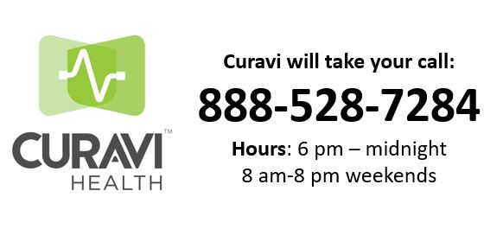
Be prepared with the following information:
Facility name, Unit
Resident Name, DOB
Attending MD
Situation, Vitals (if applicable)
Not Mandatory: Gender, Code status

Slide 7
When to Convert from Telephonic to Telemedicine Consults
Acute change in mental status/acute neurological change:
Main camera to assess general condition of the patient, mental status exam, neurological exam, and NIH Stroke Scale (NIHSS).
Exam camera to assess extraocular movement, pupillary exam, and nystagmus.
Bleeding:
Main camera to assess general condition of the patient.
Exam camera to assess for amount, location, age, and source of bleeding.
Cardiac conditions:
Stethoscope to assess heart and lung sounds.
Main camera to assess general condition and for cardiac distress.
Exam camera to assess for edema and jugular venous pressure (JVP).
EKG to assess for arrhythmia or ischemia.
Ear/nose/throat conditions:
Otoscope and/or exam camera to assess for sinusitis, otitis media, externa, and pharyngitis.
Falls and gait impairment/musculoskeletal complaints:
Main camera to assess general condition, limbs, gait, and neurological exam.
Exam camera to assess for injuries, lacerations, and swollen joints.

Slide 8
When to Convert from Telephonic to Telemedicine Consults
Fever:
Main camera to assess general condition.
Stethoscope to assess cardiac condition.
Stethoscope to assess pulmonary condition.
Exam camera to assess skin condition.
Gastrointestinal conditions:
Main camera to assess general condition, abdominal distress, rebound and/or guarding.
Exam camera to assess for jaundice and/or abdominal distention.
Stethoscope to assess for example abdominal sounds.
Pain management:
Main camera to assess general condition and pain assessment.
Exam camera to assess for any focal pain and or tenderness.
Pulmonary conditions:
Stethoscope to assess lung and heart sounds.
Main camera to assess general condition and respiratory distress.
Renal and electrolyte abnormalities:
Main camera to assess general condition.
Exam camera to assess for edema, skin turgor, and JVP.
EKG to assess for arrhythmia.
Skin conditions/wound care:
Main camera to assess general condition.
Exam camera to assess for example lower extremity edema, rash, wound infection, and cellulitis.

Slide 9
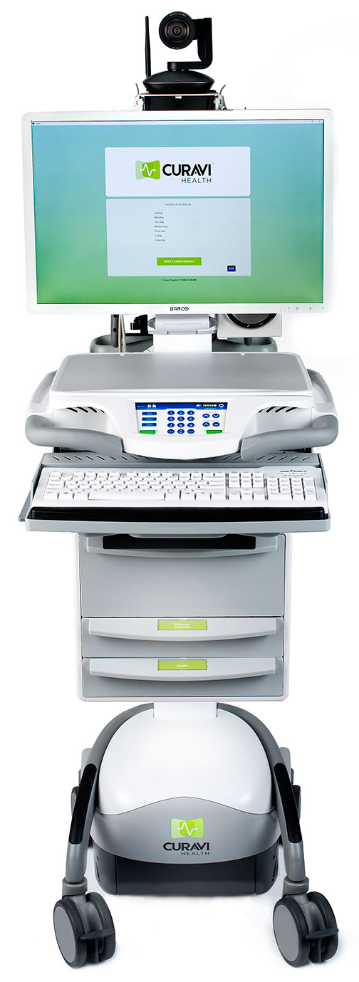
CuraviCartTM
Pan tilt zoom camera Remote in drawer
EKG
Quick directions
Scanner on the back of the cart
Plug in power cord to keep the battery charged after use.
Stethoscope, Otoscope, wound camera alcohol wipes, order sheets and directions
Notes:
It is safe to wipe down each component of the cart with a standard disinfecting wipe.
The keyboard, mouse and remote control can be wiped with a standard disinfecting wipe.
The stethoscope should be wiped prior to and after placing on the resident.
Disposable otoscope tips are located in the drawer and are individual use only.
There are rechargeable batteries in for the stethoscope and otoscope in the tip draw.

Slide 11
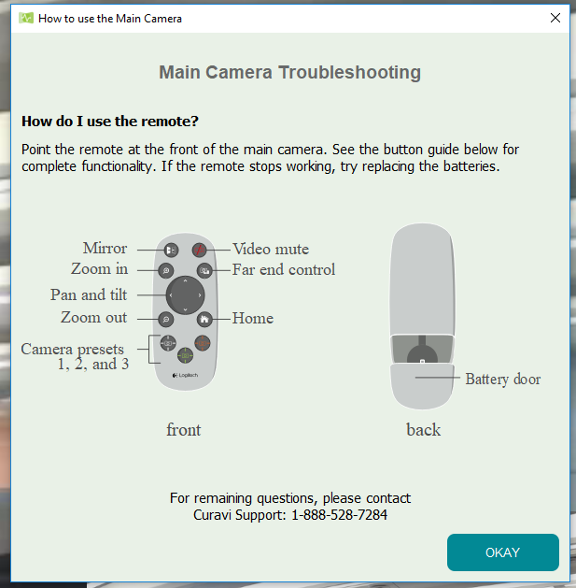
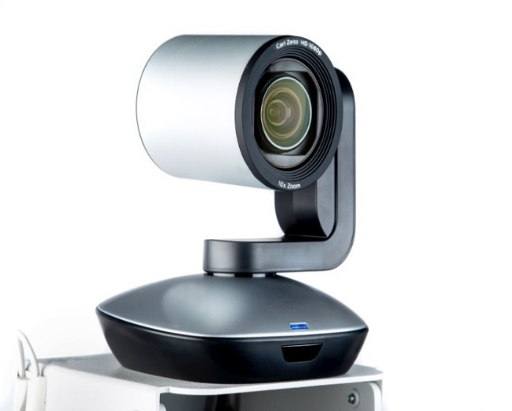
Main Camera
Remote located in the second drawer
*Telemedicine provider also has ability to move the camera
Notes:
The camera will wake up on it’s own. Please do not twist or try to adjust it by hand, this will cause it to break.
Once the consult is completed, please return the remote to the second drawer of the CuraviCartTM.
If the remote is missing, notify CuraviSupportTM ASAP. A consult can not be completed properly without the remote. You will not be able to adjust and/or zoom the camera to examine the resident.

Slide 12
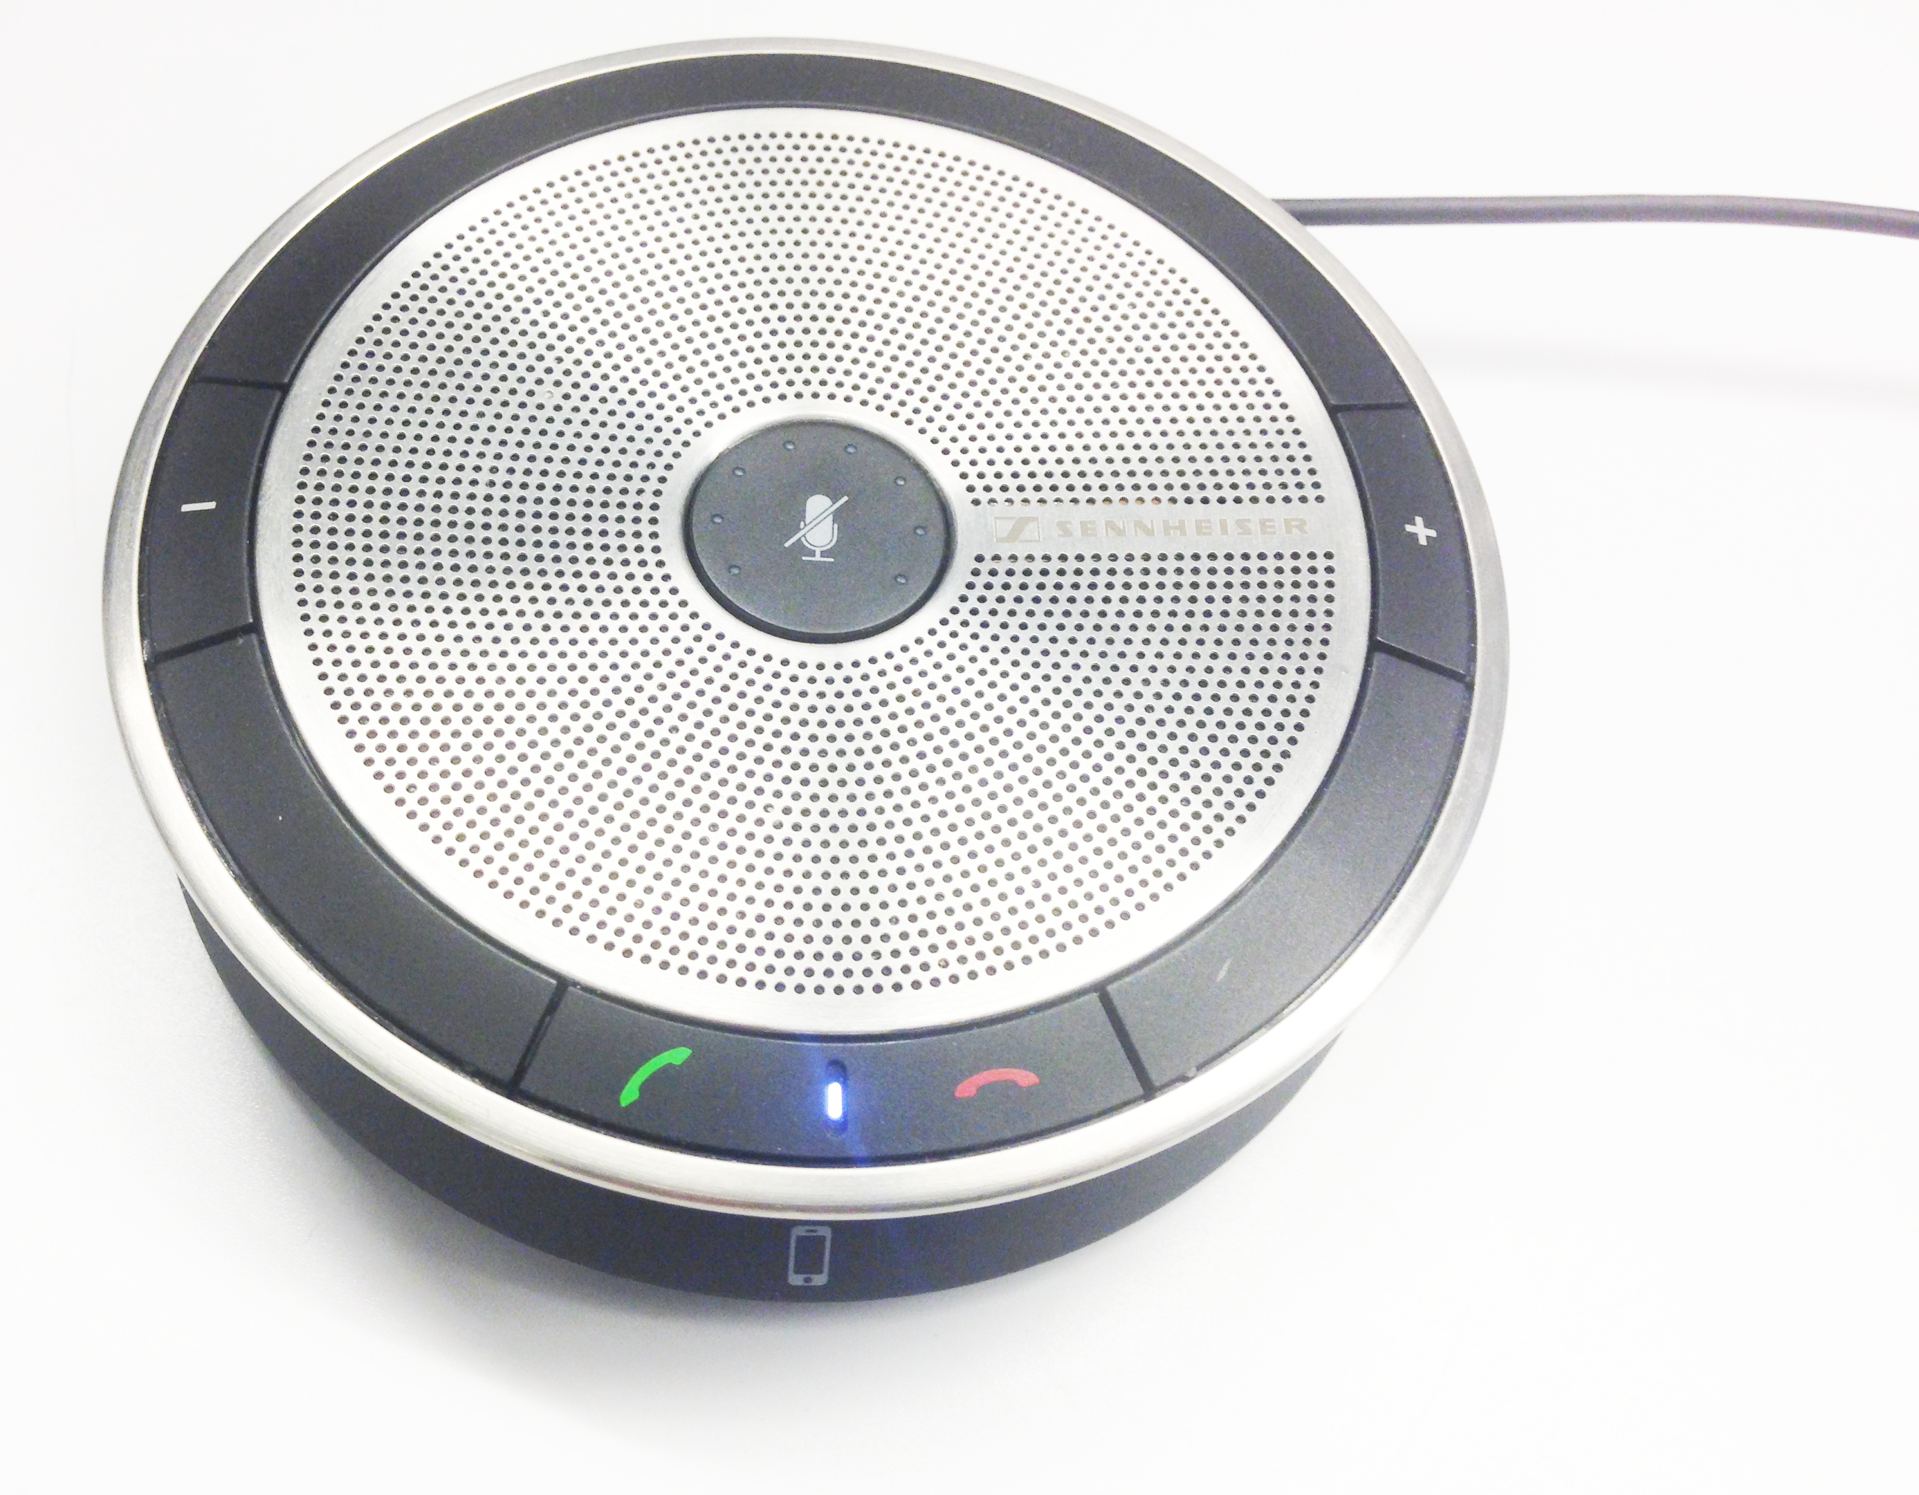
Speaker
Press to mute the microphone
Press to turn the volume up
Place it close to the resident!
To turn the volume up
Press +
To turn the volume down
Press -
To mute the microphone
Press the center button
Press to turn the volume down

Slide 13
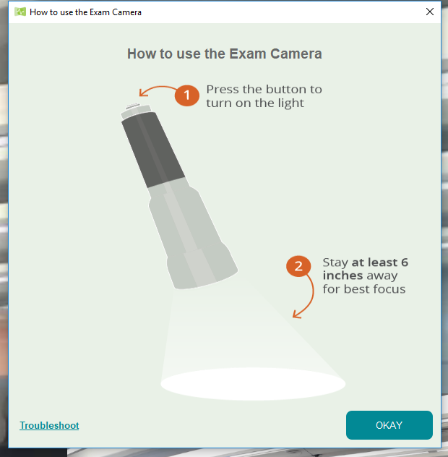
How to Use the Exam Camera
1. Click the camera icon
2. Click the camera icon to return to the Main Camera
Notes:
Hold the exam camera approximately 5 inches away from the area that is being examined. Hold it steady in order to bring the image into focus.

Slide 14
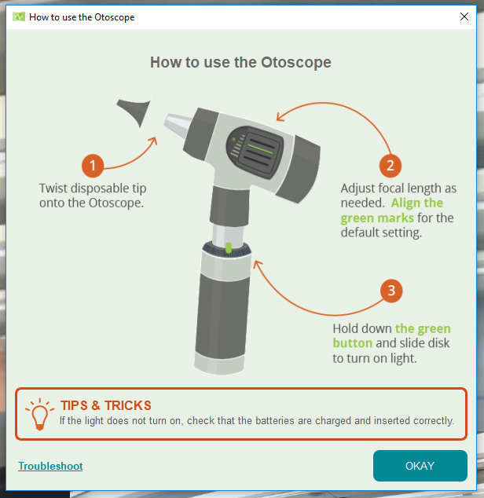
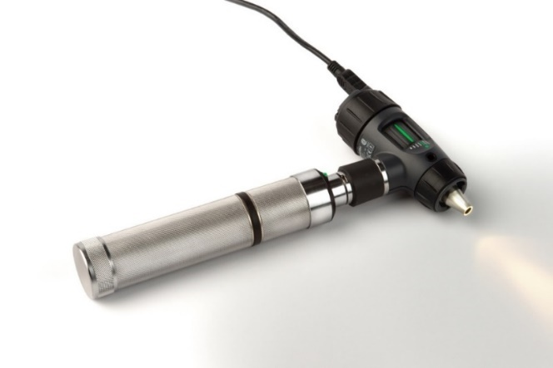
How to use the Otoscope
1. Click the camera icon
2. Click the camera icon to return to the Main Camera

Slide 15
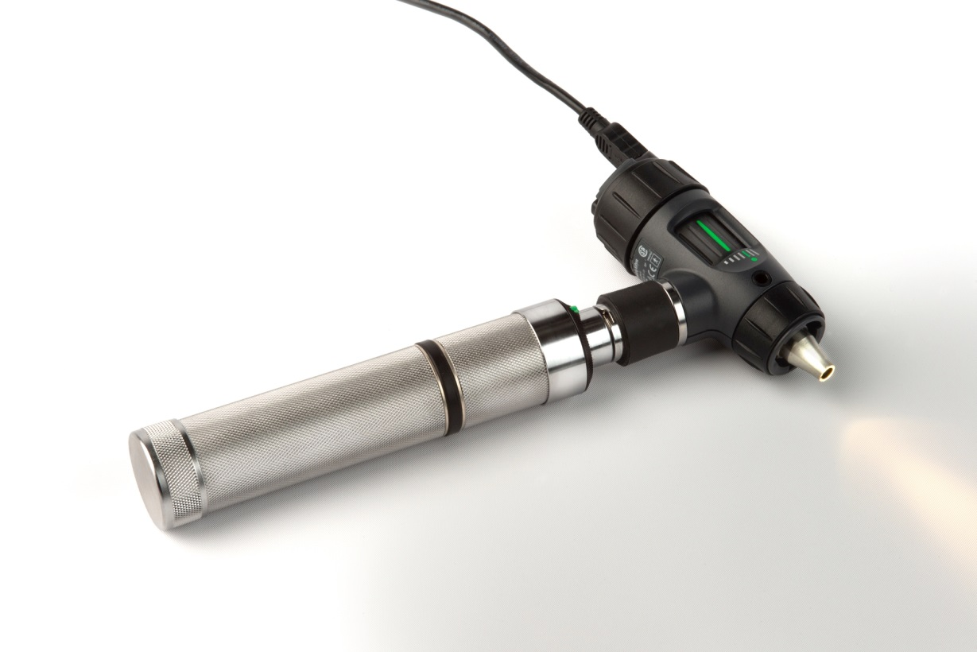
How to Change Otoscope Batteries
Unscrew the cap to expose the battery spacer. Replace the batteries with the extra AA rechargeable batteries that are located in the top draw of the CuraviCartTM

Slide 16
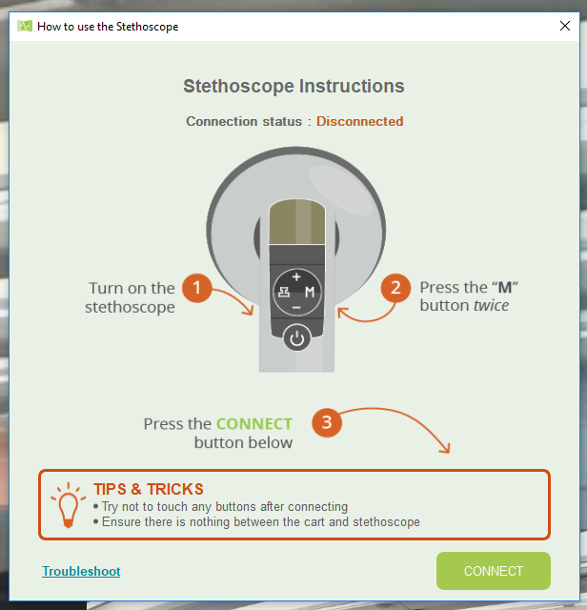
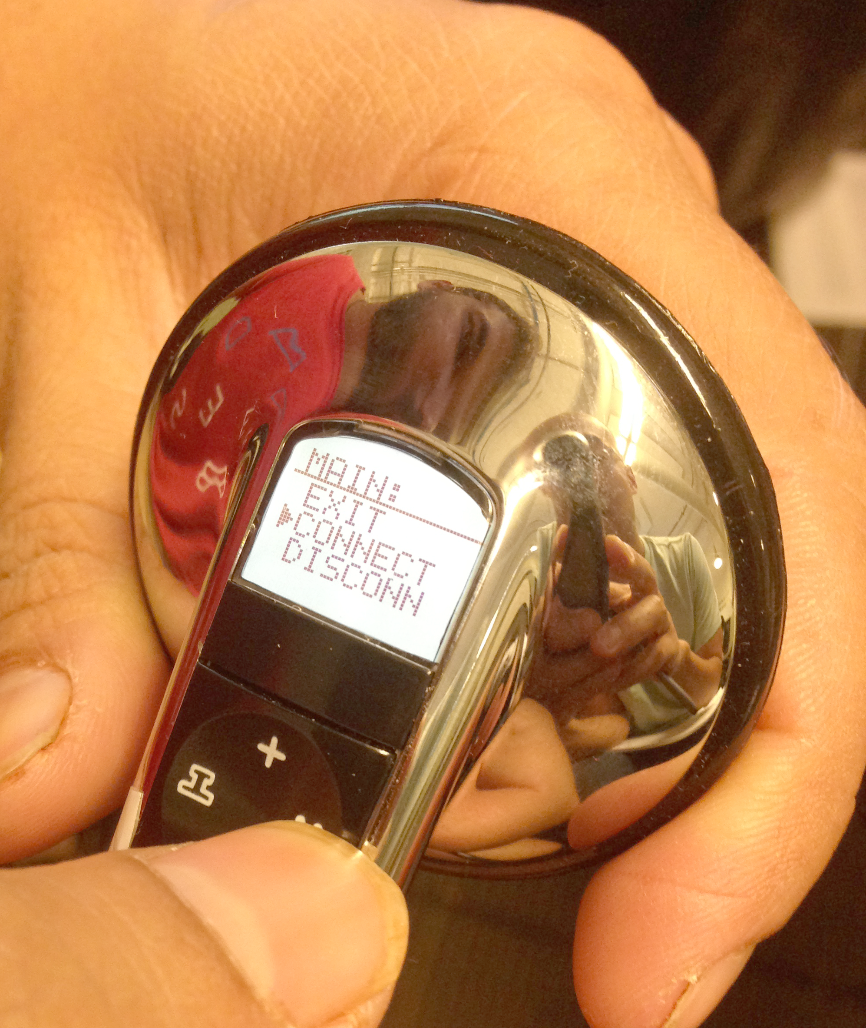
How to Use the Stethoscope
1. Click stethoscope icon
2. Click Connect

Slide 17
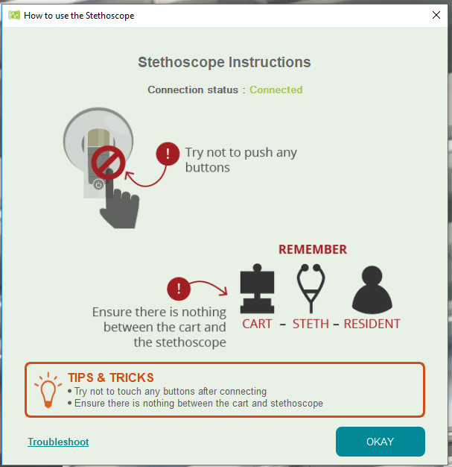
How to use the stethoscope
The stethoscope is connected!

Slide 18
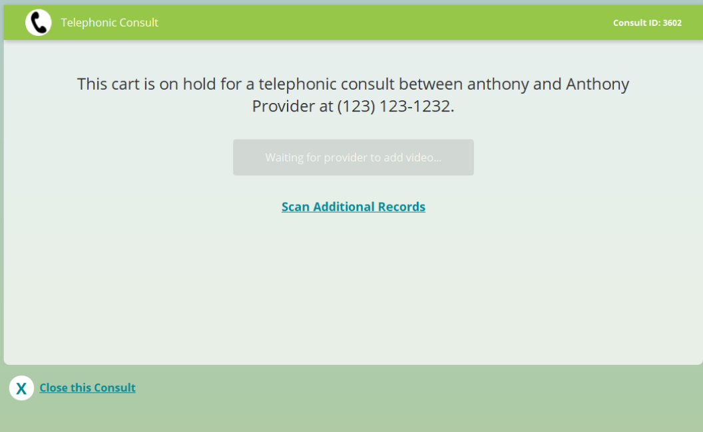
This is the screen you will see once you have called Curavi™ for a consult. You can scan documents during telephonic consult by choosing
Scan Additional Records

Slide 19
If there is sufficient information and assessment can be made, the consult will remain telephonic. At end of consult, Provider will supply verbal orders, if appropriate.
A consult summary will be faxed to the unit where resident resides, and also to the attending of record.
**If situation warrants, or documentation is needed for greater assessment, Provider can transition to telemedicine consult.**

Slide 20
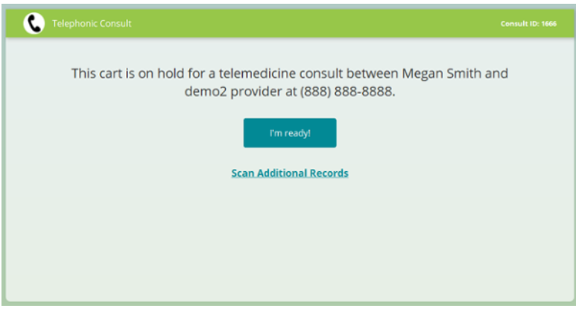
If situation requires transition to telemedicine, Provider will instruct telepresenter(nurse) to get Curavi cart and go to resident room.
Once at the Curavicart, the telepresenter chooses I'm Ready

Slide 21
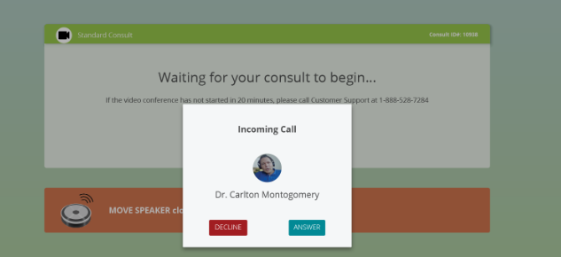
Cart dings, choose Answer to begin telemedicine consult
At end of consult, Provider will supply verbal orders, if appropriate.
A consult summary will be faxed to the unit where resident resides, and also to the attending of record.
Telepresenter(nurse) will document that a Curavi Consult took place.

Slide 23
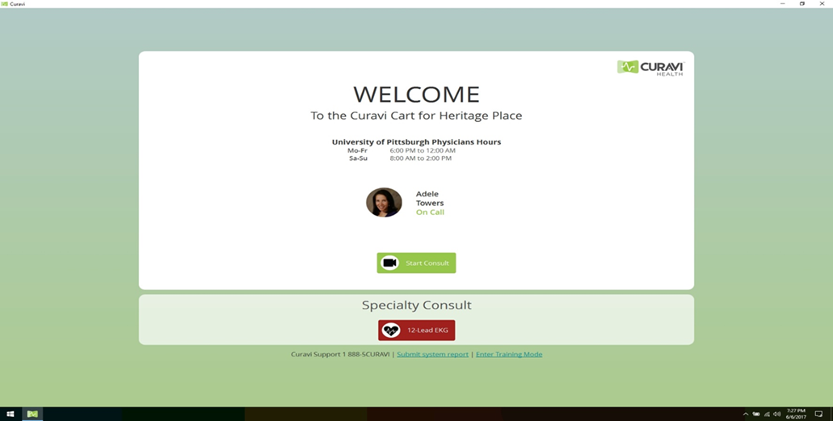
EKG Read and Interpretation
Hours of operation 8am-Midnight, 7 days per week
Your Facility Name
a
Click 12-Lead EKG to begin read

Slide 24
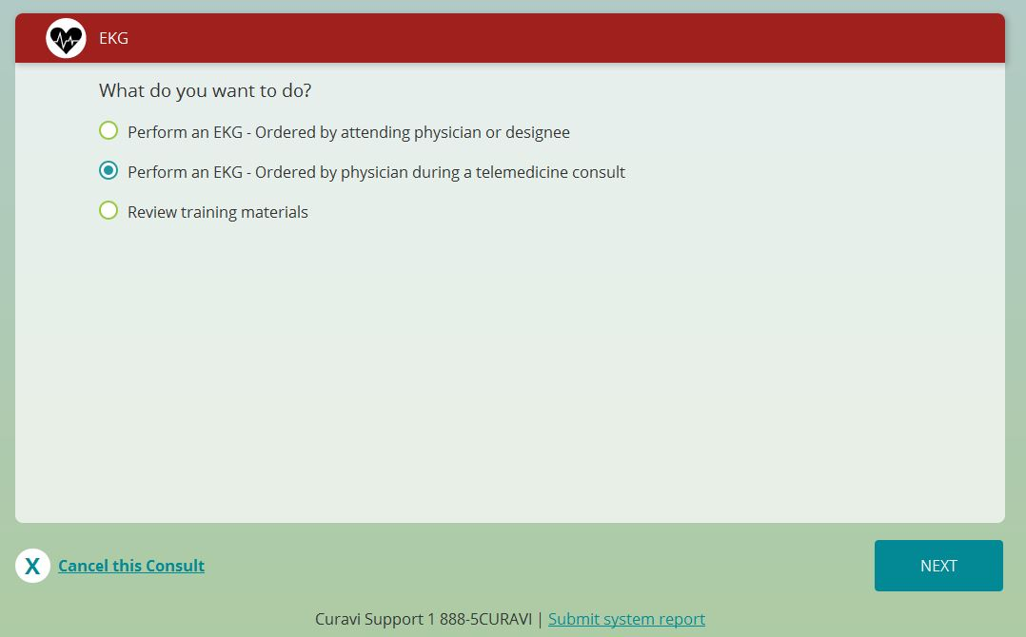
If ordered by Curavi Physician select this option.

Slide 25
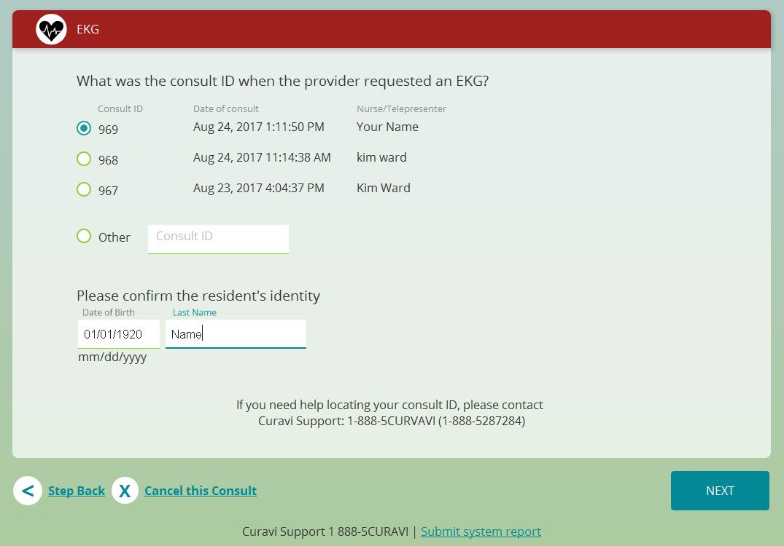
Select the consult involved with the appropriate ordered EKG
Verify last name & date of birth of the resident

Slide 26
If ordered by CRNP or attending physician select this option

Slide 27
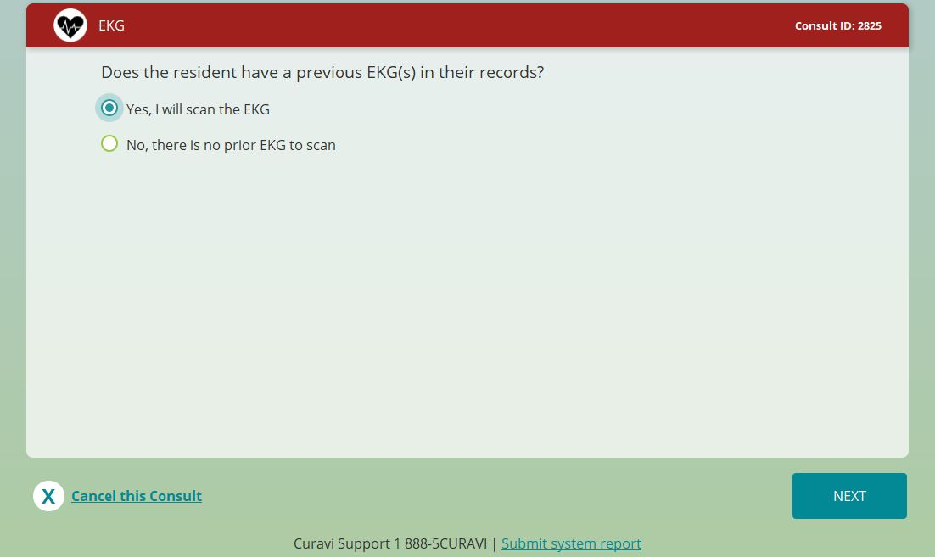
Any EKG previously performed can be scanned for comparison

Slide 28
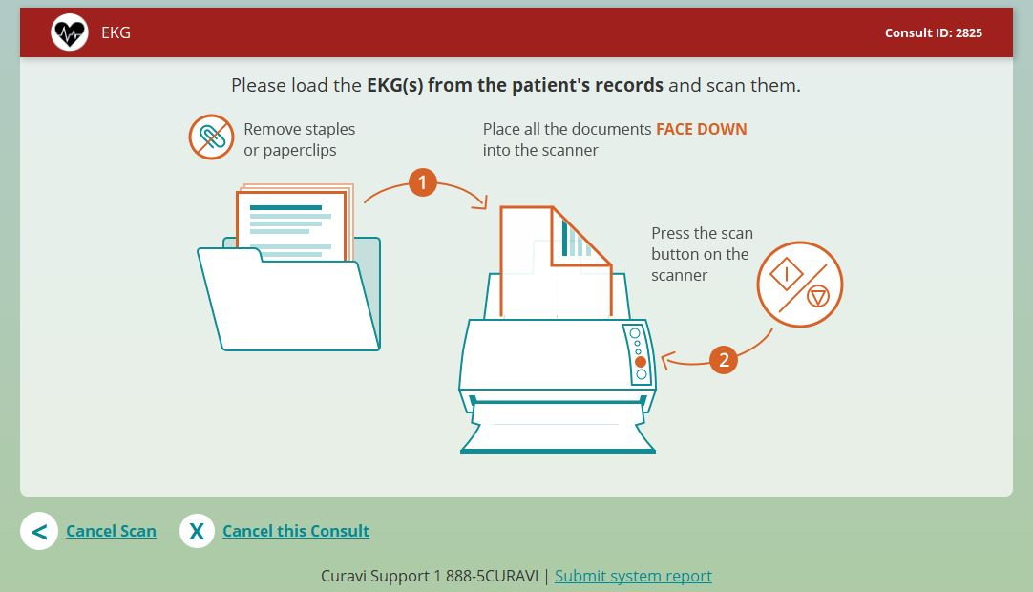
Scan comparison EKG face down

Slide 29
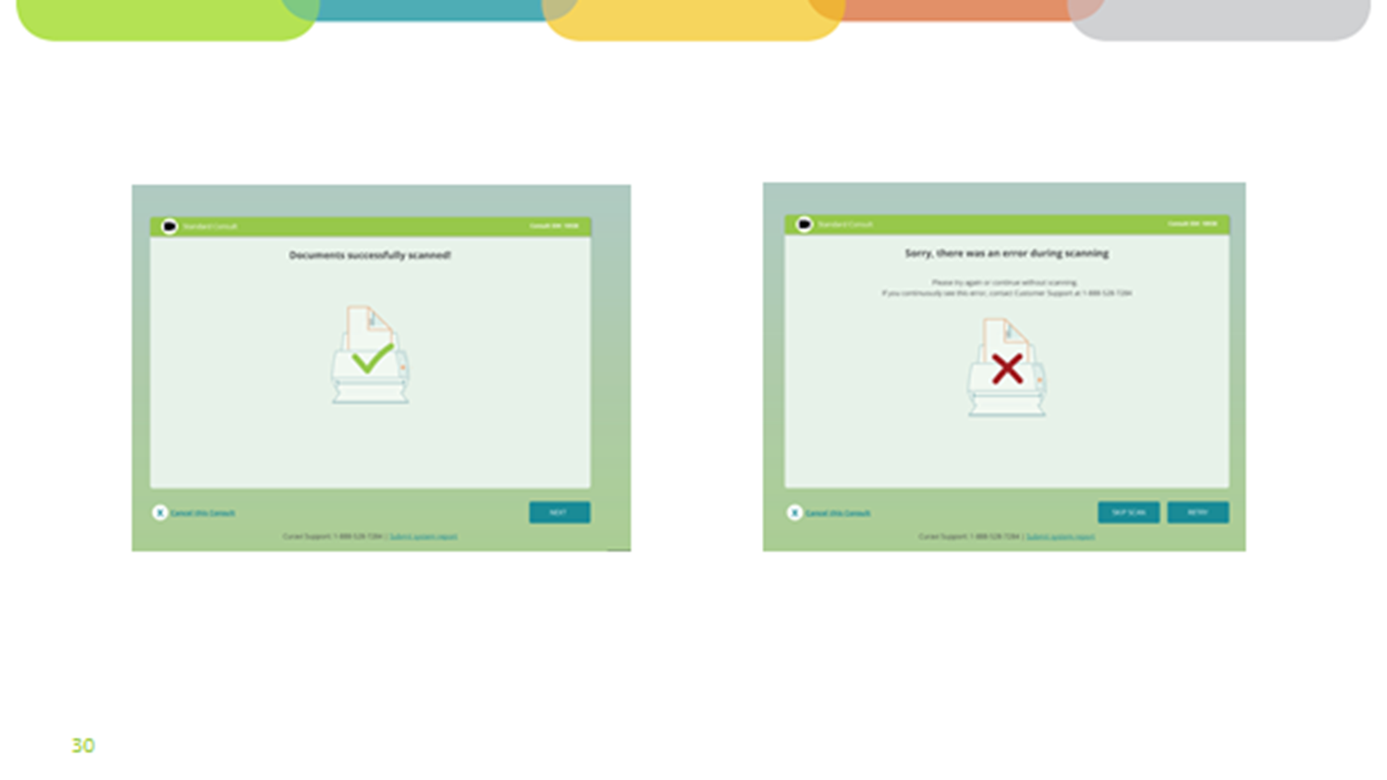

Slide 30
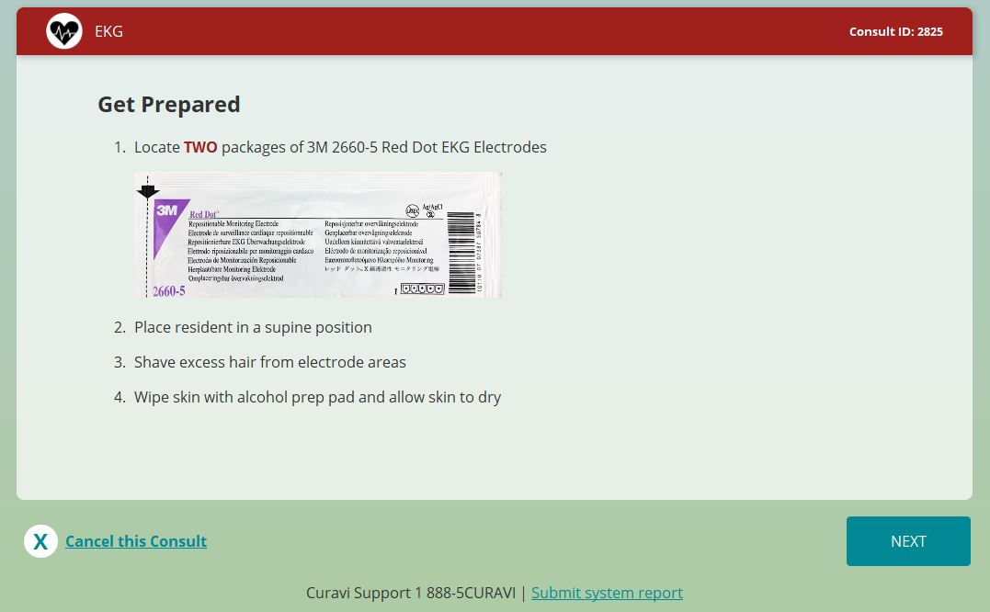

Slide 31
Review patch placement PRIOR to selecting NEXT

Slide 32
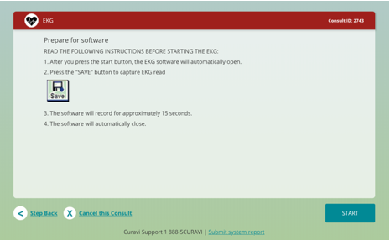

Slide 33
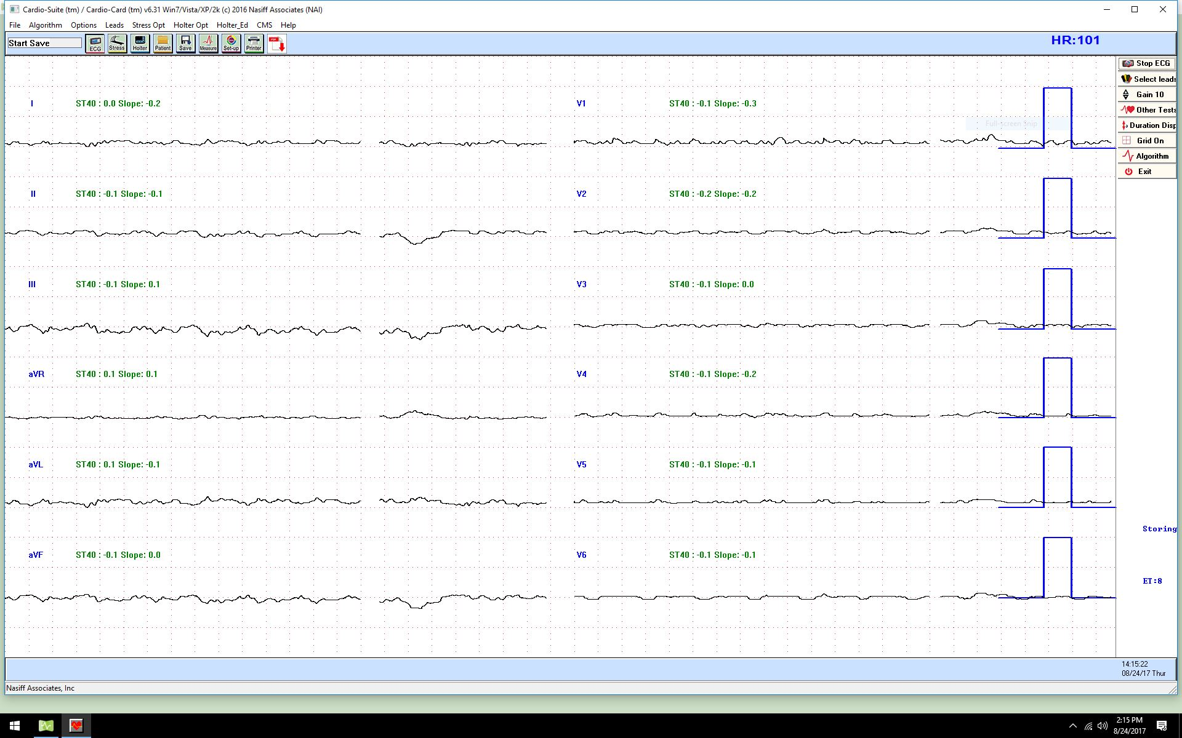
Select SAVE when ready to capture the preliminary read.
12-18 second count to completion

Slide 34
Allows you to re-adjust & try again
Sends to cardiologist & to fax machine

Slide 35
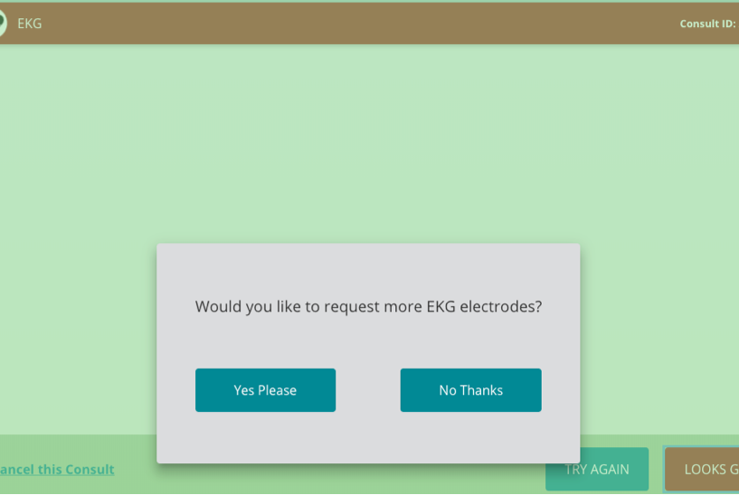

Slide 36
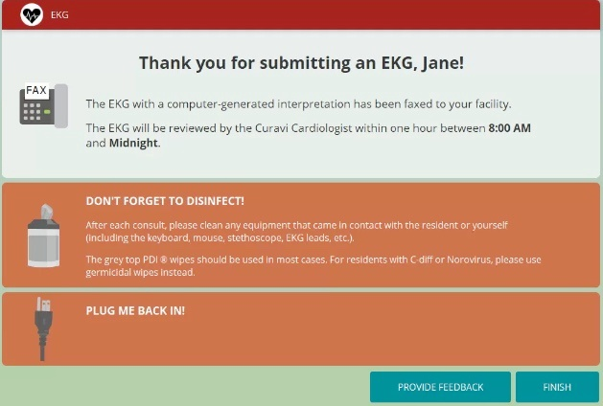

Slide 37
Having trouble?
Speaker/Microphone issues
Make sure the speaker is not muted (if light is red, make it green)
Otoscope not working
Check batteries (located in top drawer)
Check USB connection
Stethoscope not working
Check battery (located in top drawer)
Ensure Bluetooth connectivity
Internet Connectivity issue
Check wireless status
If the cart appears to be asleep or not working, it may need to be plugged in.
1-888-5CURAVI
(1-888-528-7284)

Slide 38
Video/Stethoscope Troubles During Consult?
Closing CuraviCare
Re-launching CuraviCare
Select Red close box
Click “X” at top right of the CuraviCare screen.
Select “Quit CuraviCare” from pop-up box.
Select “CuraviCare” App from desktop screen.
Wait for Curavi Physician to ((Ding)) in on Curavi Cart!
Resume consult as requested

Slide 39
Technical Support
If an issue is not resolved contact CuraviSupportTM. They are available to help 24 hours a day
1-888-5CURAVI
(1-888-528-7284)
If technical difficulties occur during a telemedicine consult, the Curavi Telemedicine Physician will call you on the phone to the determine appropriate course of action.

Slide 40
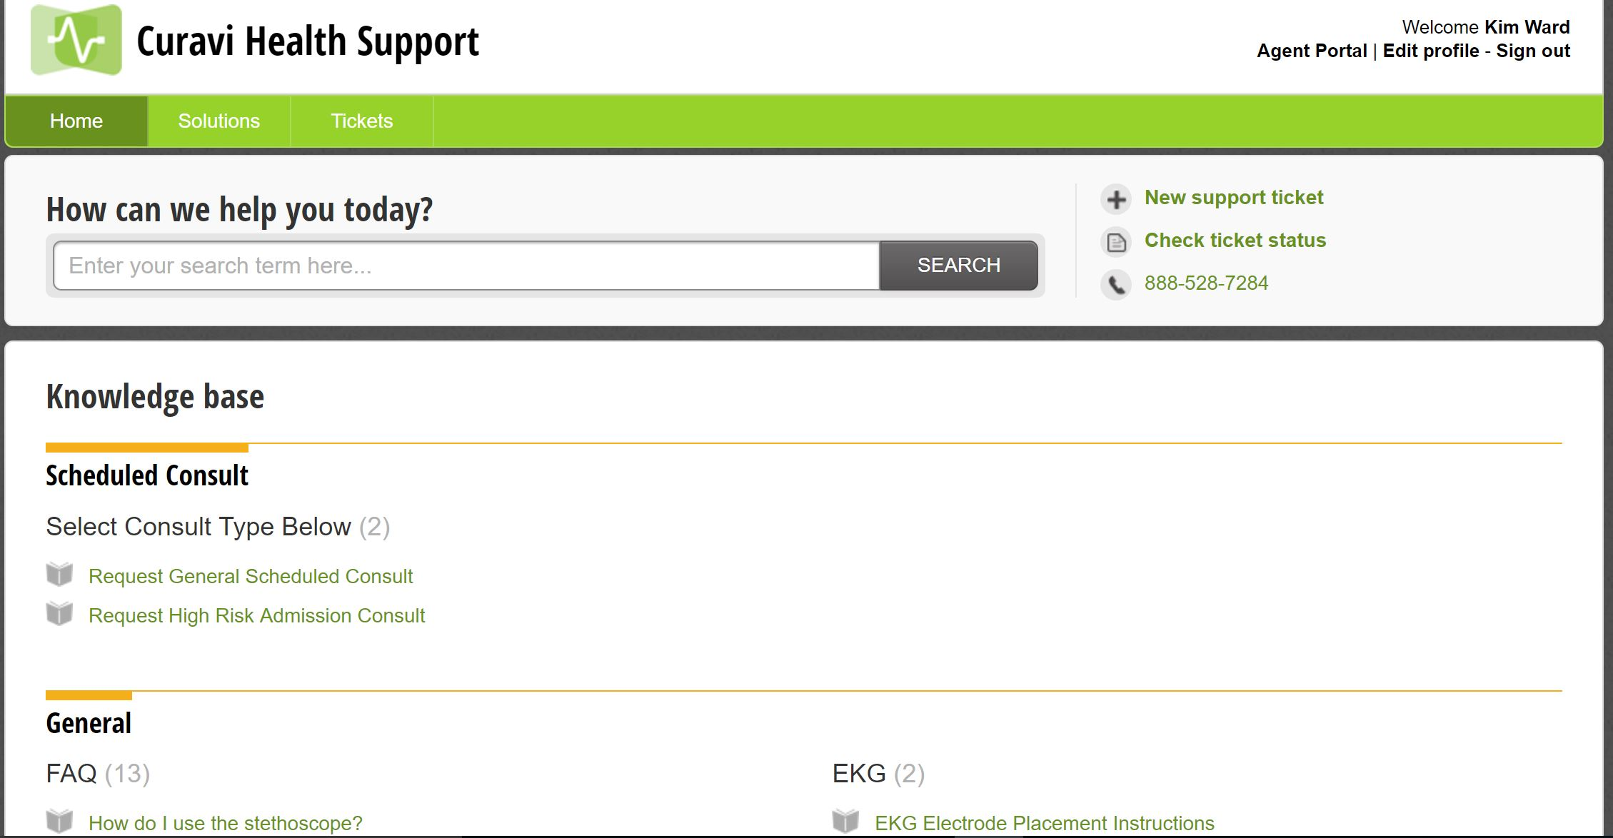
CuraviSupportTM
Notes:
CuraviSupportTM is located on the desktop of the CuravCartTM, click on the icon to open the application. This is a library of training materials that are available to help with answering common questions. CuraviSupportTM is available at all times, even when a consult is not in progress. If you have a technical difficulty, please submit a ticket. This will allow us to address your concern in an efficient manner.

Slide 41
Appendix for Train - the -Trainers Potentially Avoidable Hospitalizations

Slide 42
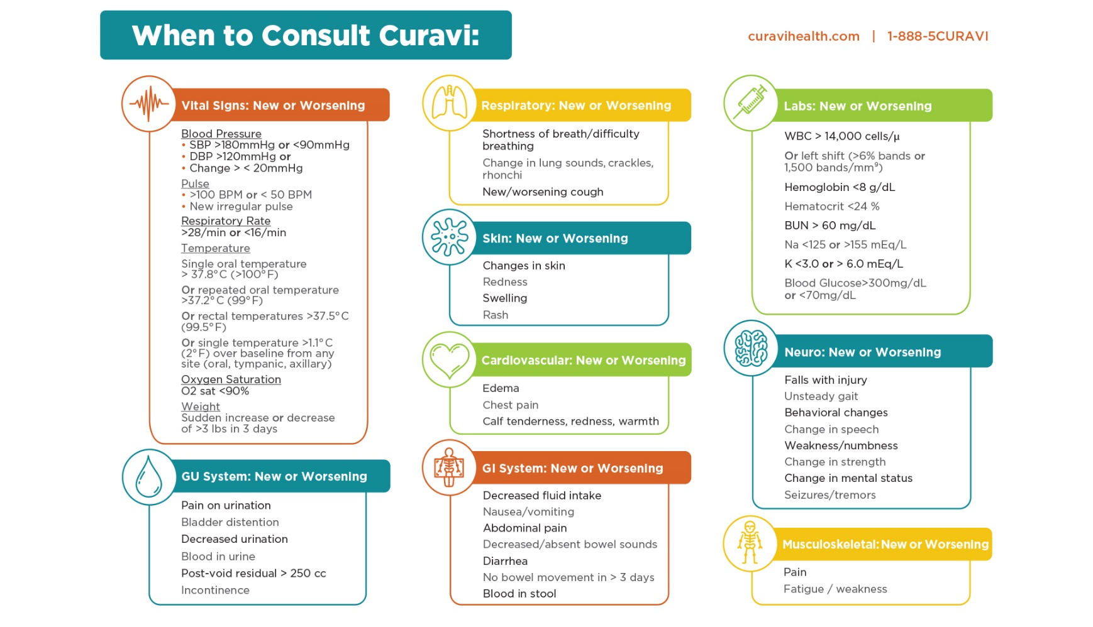
When to Consult Curavi
Notes:
These are all signs and symptoms that can lead to an acute changes of condition
Early detection = early assessment = early intervention = early treatment = quality outcomes and prevention of transfers

Slide 43
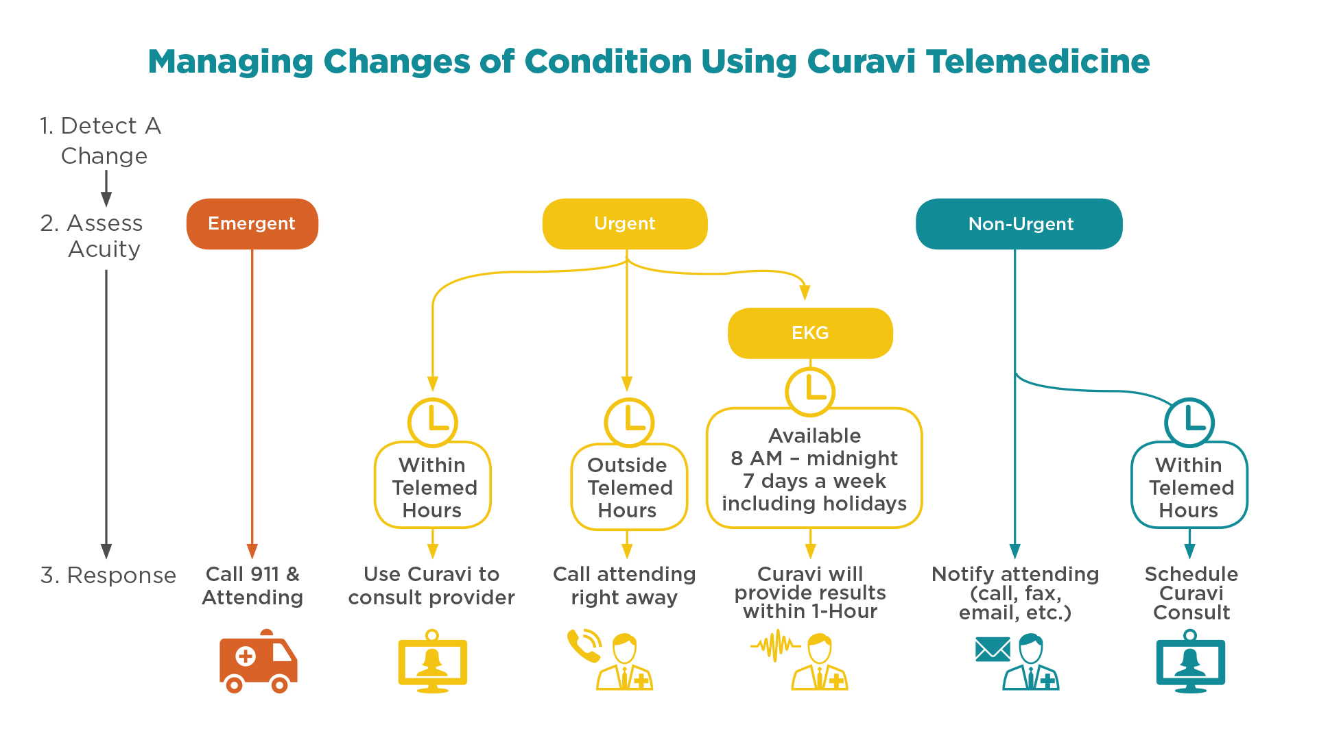
Holidays, 8 am - 2 pm
Notes:
May need to update the hours of Operation!!!
Curavi Telemedicine Hours:
Monday through Friday 6pm - 12 am
Weekends and Holidays 8am – 8pm

Slide 44
Responsibilities of the Curavi Telemedicine Physicians
Triage the telemedicine consult within 20 minutes of consult being initiated
Assess and diagnose the resident’s condition using:
Information from the scanned medical records
Verbal SBAR from the nurse
Input from the resident/family
Provide verbal orders
Document the consult in the CuraviEMRTM
Fax the consult summary to the (to the Resident's Unit)
Send the consult summary to Attending Physician and Nurse Practitioner via secure email link and fax

Slide 45
Roles and Responsibilities of the Telepresenter
The clinician (RN/LPN) at the facility who participates in the telemedicine consult:
Submits the consult request and scans documents (if necessary)
Prepares the resident
Prepares the room
Assists the Curavi Telemedicine Physician with the assessment and evaluation of the resident
Accepts and initiates verbal orders from the Curavi Telemedicine Physicians
Document in your facility charting system that resident received a Curavicare™ telemedicine consult
Notes:
A telepresenter can be a RN or LPN as long as they have been trained to use the CuraviCartTM and CuraviCareTM.
We encourage staff nurses, nurse managers, and nursing supervisors to become telepresenters – Test Question #3

Slide 46
Prepare room & resident
Set the cart close to the resident, at eye level and move the speaker close to the resident
Place hearing aid, glasses/dentures on resident as available
Turn on overhead and bed lighting
Ensure a quiet environment- Turn off the TV or radio if it is on
Ensure privacy and confidentiality by closing the door and drawing the curtain
Explain how telemedicine to the resident and/or family and that their personal information will be protected and kept private
Resident can be located in wheelchair or bed
Move the tray table to the side if it is in front of the resident
Expose area to be examined, or ensure that clothing is loose

Slide 47
Congestive Heart Failure Exacerbation Signs/Symptoms
Frequent dry hacking or moist cough
Worsening shortness of breath with activity or shortness of breath at rest
Increased discomfort or swelling (edema) in the legs, feet, and ankles
Lung sounds – new or worsening rales
Sudden weight gain of more than 2-3lbs in a 24 hr. period, 5 lbs. in a week
Discomfort or swelling in the abdomen
Trouble sleeping, cannot lie flat
New or worsening dizziness, confusion, sadness, depression, or fatigue
Loss of appetite
Fall
BNP>300
http://www.heart.org/idc/groups/heart-public/@wcm/@hcm/documents/downloadable/ucm_477328.pdf)
Notes:
* Blood Oxygen saturation level below 92% on room air or on usual O2 settings in patients with chronic oxygen requirements.
* New or worsening rales in lungs
* New or worsening edema
* New or increased jugular-venous distension
*BNP > 300

Slide 48
Pneumonia Signs/Symptoms
Cough with phlegm
Chest pain when breathing or coughing,
Labored breathing or shortness of breath (RR>24)
Blood Oxygen saturation level < 92% on room air or on usual O2 settings in patients with chronic oxygen requirements.
Evidence of focal pulmonary consolidation including rales, rhonchi, decreased breathe sounds, or dullness to percussion
Coughing up phlegm
Fever, chills * older adults sometimes have lower than normal body temperature
Feels suddenly worse after a cold or flu
Nausea, vomiting, diarrhea
Confusion, delirium
http://www.nhlbi.nih.gov/health/health-topics/topics/pnu/signs
Notes:
* Fever >100 F (oral) or two degrees above baseline
* Blood Oxygen saturation level < 92% on room air or on usual O2 settings in patients with chronic oxygen requirements
* Respiratory rate above 24 breaths/minute
* Evidence of focal pulmonary consolidation including rales, rhonchi, decreased breath sounds, or dullness to percussion

Slide 49
COPD/Asthma Exacerbation Signs/Symptoms
Sudden or sustained worsening of dyspnea
O2sat 92% or less on RA, RR >24
Wheezing
Cough, or sputum production, or change in viscosity, color, volume
Increased use of maintenance medications
Elevated temp and pulse rates, drop in BP & and change in mental status in critically ill individuals
http://rnao.ca/sites/rnao-ca/files/Nursing_Care_of_Dyspnea_-The_6th_Vital_Sign_in_Individuals_with_Chronic_Obstructive_Pulmonary_Disease.pdf
Notes:
Symptoms of wheezing, shortness of breath, or increased sputum production
* Blood Oxygen saturation level below 92% on room air or on usual O2 settings in patients with chronic oxygen requirements
* Acute reduction in Peak Flow or FEV1 on spirometry
* Respiratory rate > 24 breaths/minute

Slide 50
UTI Signs/Symptoms
Change in mental status
Lower Abdominal pain
Shaky, weak, muscle aches
Urine may look cloudy, bloody or foul smelling
Fever not attributed to any other cause
Peripheral WBC count >14000.
Dysuria, new or increased urinary frequency, new or increased urinary incontinence, gross hematuria, or acute costovertebral angle pain or tenderness
Fall
https://www.niddk.nih.gov/health-information/health-topics/urologic-disease/urinary-tract-infections-in-adults/Pages/facts.aspx#signs
Notes:
Fever > 100 F (oral) or two degrees above baseline
* Peripheral WBC count > 14,000.
* Symptoms of: dysuria, new or increased urinary frequency, new or increased urinary incontinence, altered mental status, gross hematuria, or acute costovertebral angle pain or tenderness

Slide 51
Dehydration / Acute Kidney Injury
Reduced urine output in 24 hours or reduced oral intake by approximately 25% or more of average intake for 3 consecutive days
New onset of Systolic BP < 100 mm Hg (Lying, sitting or standing)
20% increase in Blood Urea nitrogen (e.g. from 20 to 24) OR 20% increase in Serum Creatinine (e.g. from 1.0 to 1.2)
Sodium > 145 or < 135
Orthostatic drop in systolic BP of 20 mmHg or more going from supine to sitting or standing
Fall
Change in mental status
Notes:
* Reduced urine output in 24 hours or reduced oral intake by approximately 25% or more of average intake for 3 consecutive days
* New onset of Systolic BP < 100 mm Hg (Lying, sitting or standing)
* 20% increase in Blood Urea nitrogen (e.g. from 20 to 24) OR 20% increase in Serum Creatinine (e.g. from 1.0 to 1.2)
* Sodium > 145 or < 135
* Orthostatic drop in systolic BP of 20 mmHg or more going from supine to sitting or standing

Slide 52
Skin Ulcers / Surgical Wound Infection / Cellulitis
New onset of painful, warm, reddened, and/or swollen/indurated area of skin
If associated with a skin ulcer or wound there is change of condition with signs of infection such as purulence, exudate, fever, new onset of pain, and/or induration
Fever
Drainage from surgical site, reddened, and/or swollen incisional area
Notes:
New onset of painful, warm and/or swollen/indurated skin infection
If associated with a skin ulcer or wound there is an acute change in condition with signs of infection such as purulence, exudate, fever, new onset of pain, and/or induration.

