Slide 1
Telepresenter Training

Slide 2
What is ACOC?
An acute change of condition (ACOC) is a sudden, clinically important deviation from a resident’s baseline in physical, cognitive, behavioral, or functional domains.
Notes:
Allow staff to identify potential Curavicare™ cases
https://www.nhqualitycampaign.org/files/Acute_Change_in_Condition_Reference.pdf

Slide 3
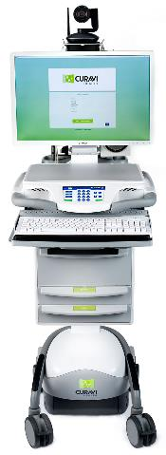
Let’s meet the CuraviCart™
Notes:
Use the cart to display the items that are contained on the next slide.

Slide 4
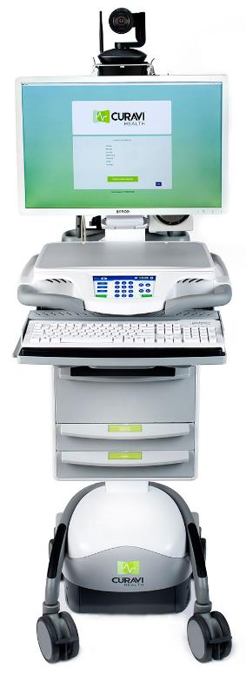
CuraviCart™
Pan tilt zoom camera Remote in drawer
EKG
Quick directions
Scanner on the back of the cart
Plug in power cord to keep the battery charged after use.
Stethoscope, Otoscope, wound camera alcohol wipes, order sheets and directions
Notes:
It is safe to wipe down each component of the cart with a standard disinfecting wipe.
The keyboard, mouse and remote control can be wiped with a standard disinfecting wipe.
The stethoscope should be wiped prior to and after placing on the resident.
Disposable otoscope tips are located in the drawer and are individual use only.
There are rechargeable batteries in for the stethoscope and otoscope in the tip draw.

Slide 5
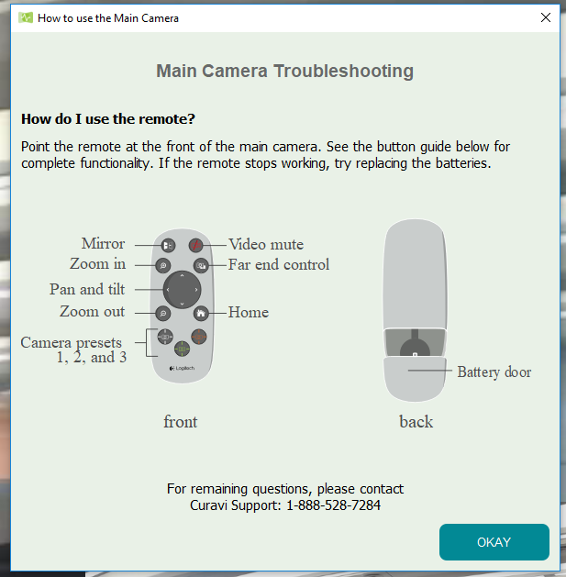
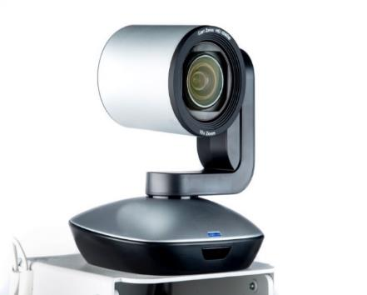
Main Camera
Remote located in the second drawer
Notes:
The camera will wake up & centers when video consult begins.
Please do not twist or try to adjust by hand.
Please return the remote to the second drawer of the CuraviCartTM. If the remote is missing, notify CuraviSupportTM ASAP. You will not be able to adjust and/or zoom the camera to examine the resident.

Slide 6
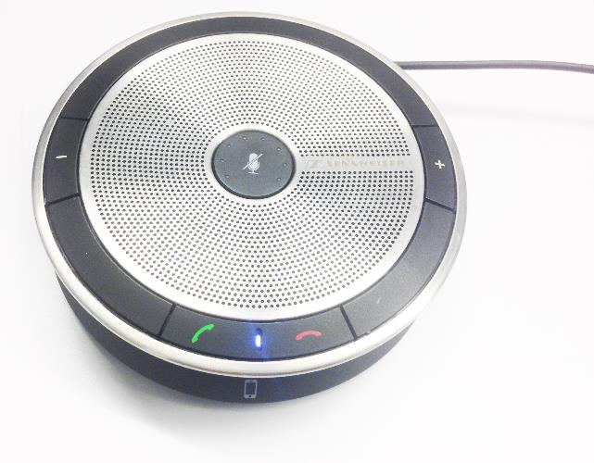
Speaker
Press to mute the microphone
Press to turn the volume up
Place it close to the resident!
To turn the volume up
Press +
To turn the volume down
Press -
To mute the microphone
Press the center button
Press to turn the volume down
Notes:
Green for go! All green light dots should be lit at all times during consult
All red dots mute the microphone. The provider will not be able to hear you!
Center button must be selected to unmute, regardless of using +/- symbol to adjust the volume
Long cord, allow resident to hold if necessary to hear & to speak into. Speaker & microphone dual function!

Slide 7
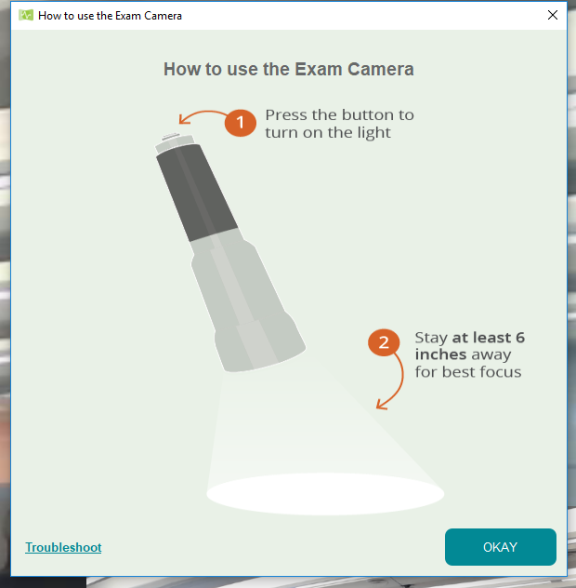
How to Use the Exam Camera
1. Click the camera icon & select “Exam Camera”
2. Click the camera icon to return to the Main Camera
Notes:
Hold the exam camera approximately 6 inches away from the area that is being examined, and slowly bring closer to the area you are choosing to examine.
Hold steady to active the auto focus feature
If image is not clear, you can reset the camera by pointing it to the Curavicare™ work surface & then back to area of exam.

Slide 8
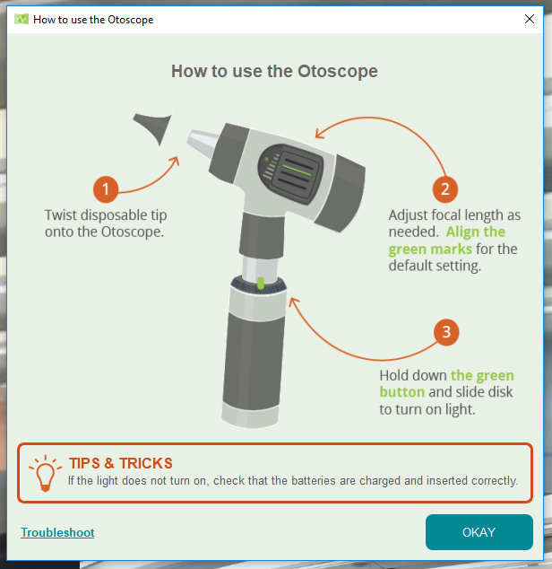
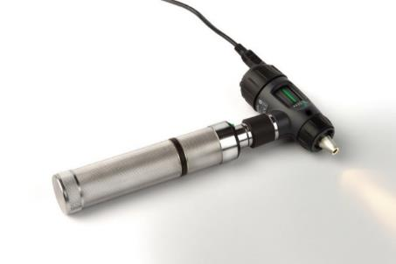
How to use the Otoscope
1. Click the camera icon
2. Click the camera icon to return to the Main Camera
Notes:
Check light brightness once turned on, if dim or no light showing, please change the batteries located in the first drawer
Pull up on the pinna part of the ear
Place stethoscope directly into open canal, should allow view of the ear drum(Pearl)

Slide 9
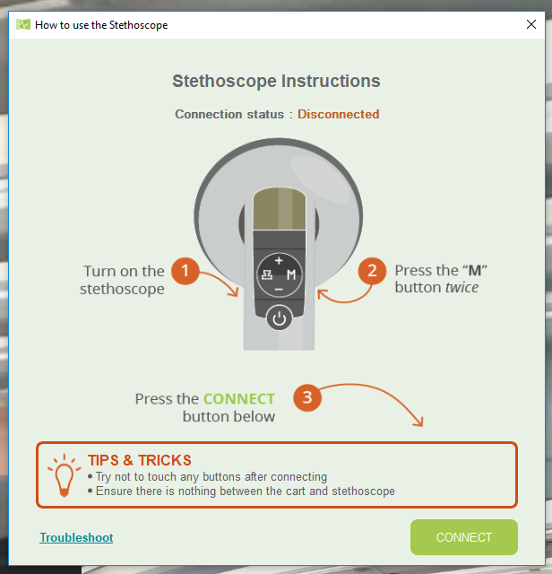
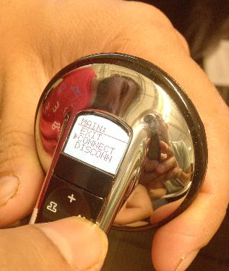
How to Use the Stethoscope
1. Click stethoscope icon
2. Click Connect
Notes:
Please follow directions to connect stethoscope on the CuraviCart screen
Press power button, followed by “M” button twice
Check stethoscope function screen; a flashing bluetooth symbol should be to the right of this viewing screen on the stethoscope

Slide 10
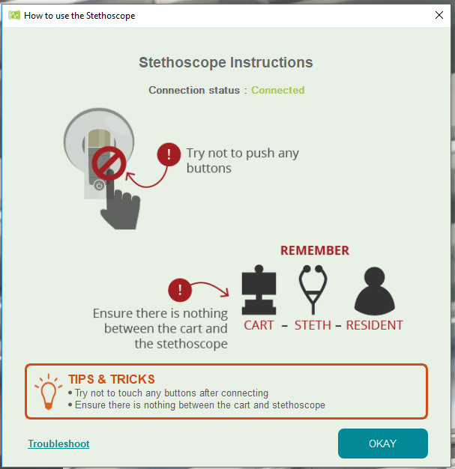
How to use the stethoscope
The stethoscope is connected!
Notes:
Periodically glance at your screen to ensure the connection status still reads “connected” as it may become “disconnected” depending on distance & body position
Leave stethoscope probe out of your ear that is facing the telemedicine cart. This will allow you to be able to hear the physician for stethoscope placement instructions

Slide 11
The Value of Telemedicine
24 hour/7 days a week physician support
Physician triage within 20 minutes of initiating a consult
Allows the nurse, resident/family, and physician to see and hear each other during an assessment
Enhanced clinical assessments
Residents treated in place
Notes:
Curavi means “to care for” in Latin
CuraviCartTM= The telemedicine cart
CuraviCareTM = The software that is used on the CuraviCartTM to conduct a telemedicine visit. It is HIPAA complaint.
The following types of residents can benefit from a telemedicine consult? – Test Question #6
Short-term/sub-acute residents
Long-term Care residents
New admissions
Hospice residents
Residents that will be discharged tomorrow

Slide 12
Communicating Changes of Condition
SBAR: a technique to communicate a resident’s change of condition
Situation (a concise statement of the problem)
Background (pertinent and brief information related to the situation)
Assessment (what you found/think)
Recommendation (recommended action— what you want)
Notes:
SBAR is a structured technique that can be used to facilitate prompt and appropriate communication.
SBAR improves communication accuracy
SBARs can be written or verbal
The telemedicine Physicians are trained in SBAR communication and with telemedicine, an SBAR can be communicated verbally.

Slide 13
Potentially Avoidable Hospitalizations – What is the complete list?
Acute Renal Failure (AKI)
Altered mental status
Anemia
C. Difficile infection
CHF (Congestive Heart Failure)
Constipation / Impaction
COPD / Asthma
Diarrhea / Gastroenteritis
Dehydration
Failure to thrive
Falls and Trauma
HTN (hypertension)
Pneumonia / Bronchitis
Nutritional deficiency
Poor glycemic control
Psychosis
Seizures
Skin Ulcers / Cellulitis
UTI (urinary tract infection)
https://www.cms.gov/Research-Statistics-Data-and-Systems/Statistics-Trends-and-Reports/Reports/downloads/costdriverstask2.pdf
CONFIDENTIAL & PROPRIETARY TO CURAVI HEALTH
Notes:
26% of all hospitalizations are considered to be potentially avoidable
6 Conditions are responsible for 80% of PAHs:
Pneumonia (32.8%)
UTI (14.2%)
CHF (11.6%)
Dehydration (10.3%)
COPD / Asthma (6.5%)
Skin Ulcers, cellulitis (4.9%)

Slide 14
Notes:
These are all signs and symptoms that can lead to an acute changes of condition
Early detection = early assessment = early intervention = early treatment = quality outcomes and prevention of transfers

Slide 15
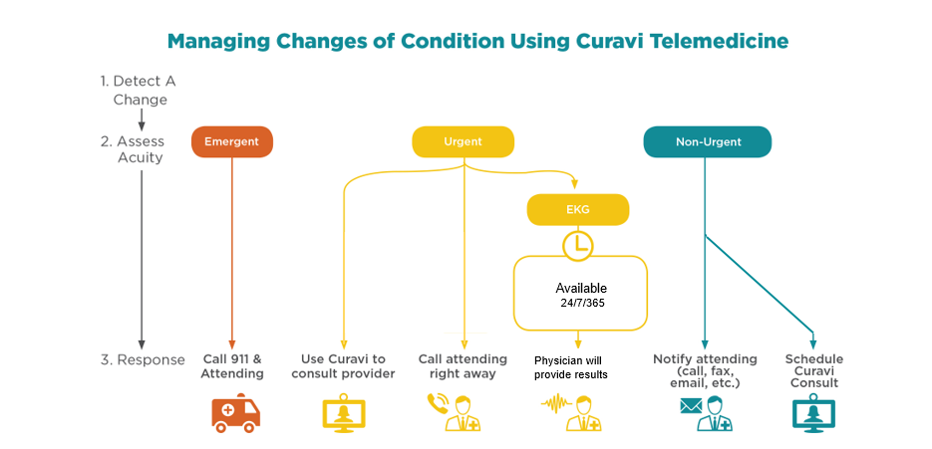
Notes:
***THIS infographic may not match your facility workflow, and it can be customized for you. Contact your account manager for an updated version!***
Telemedicine Hours:
24hrs, 7days a week

Slide 16
Responsibilities of the Telemedicine Physicians
Triage the telemedicine consult within 20 minutes of consult being initiated
Assess and diagnose the resident’s condition using:
Information from the scanned medical records
Verbal SBAR from the nurse
Input from the resident/family
Provide verbal orders
Documentation of the consult
Notes:
This workflow may not match the workflow at your facility. Please contact your account manager for questions.

Slide 17
Roles and Responsibilities of the Telepresenter
The clinician (RN/LPN) at the facility who participates in the telemedicine consult:
Submits the consult request and scans documents if necessary
Prepares the resident
Prepares the room
Assists the telemedicine physician with the assessment and evaluation of the resident
Coordinates follow-up
Accepts and initiates verbal orders from the telemedicine physician
Document that a CuraviCare™ telemedicine consult occurred in the EMR
Notes:
A telepresenter can be a RN or LPN as long as they have been trained to use the CuraviCartTM and CuraviCareTM.
We encourage staff nurses, nurse managers, and nursing supervisors to become telepresenters – Test Question #3

Slide 18
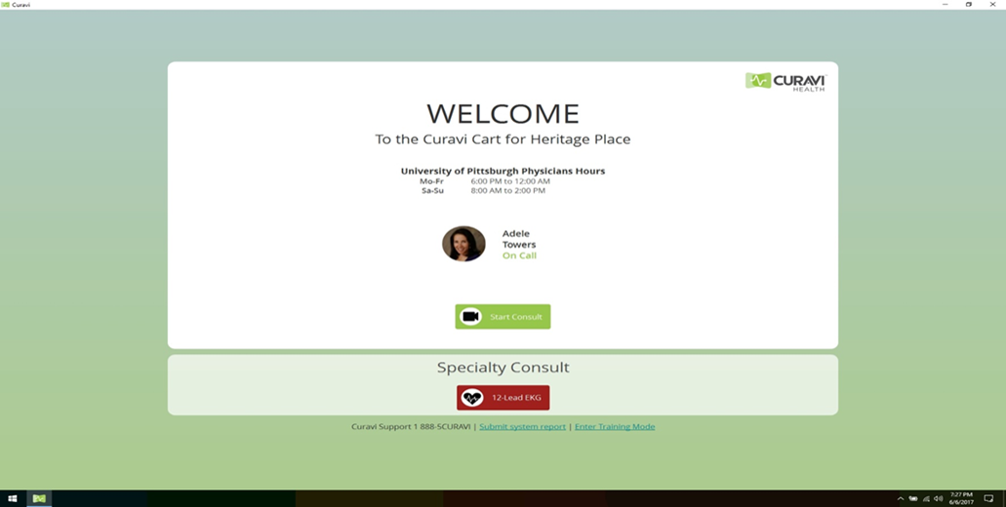
An introduction to CuraviCareTM
a
Click “Start Consult” to begin
Notes:
Provide a brief overview of each screen and explain the purpose of the information that is contained in each screen. Select “cancel” at the end of the last screen to prevent the initiation of a consult.
Explain that the typical telemedicine consult should take 45 minutes from start to finish – Test Question #1
Explain that Telemedicine Physician will triage the consult within 20 minutes of the consult request – Test Question #2

Slide 19
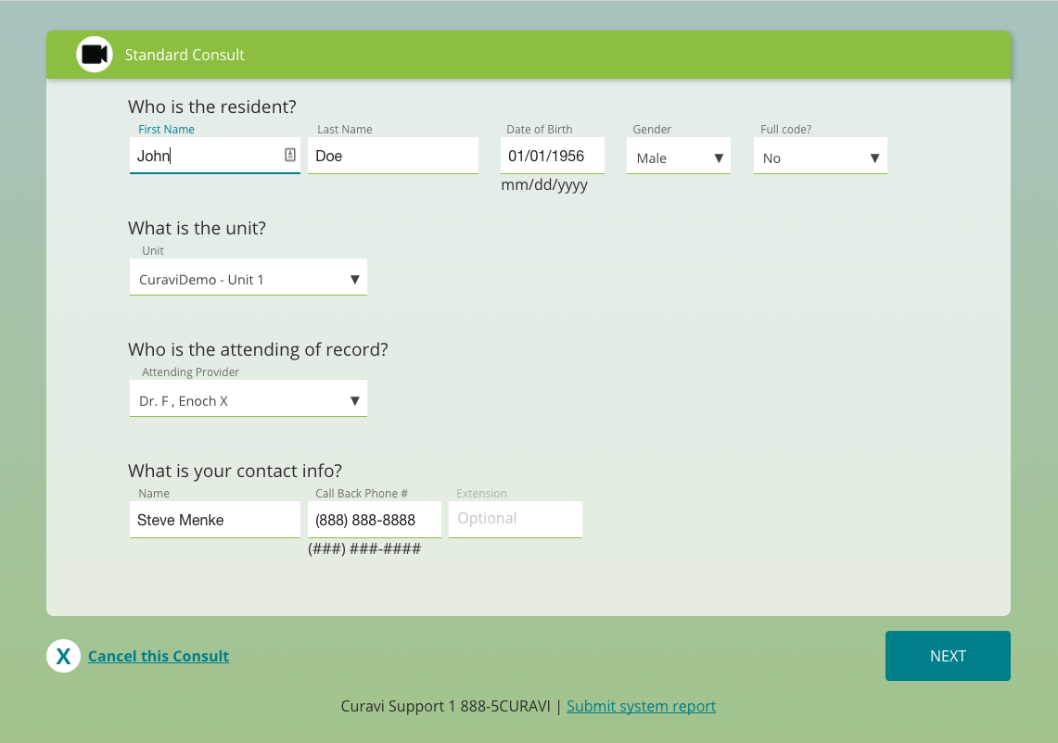
Notes:
Consult ID & Extension are not required fields
Match the correct information from residents face sheet

Slide 20
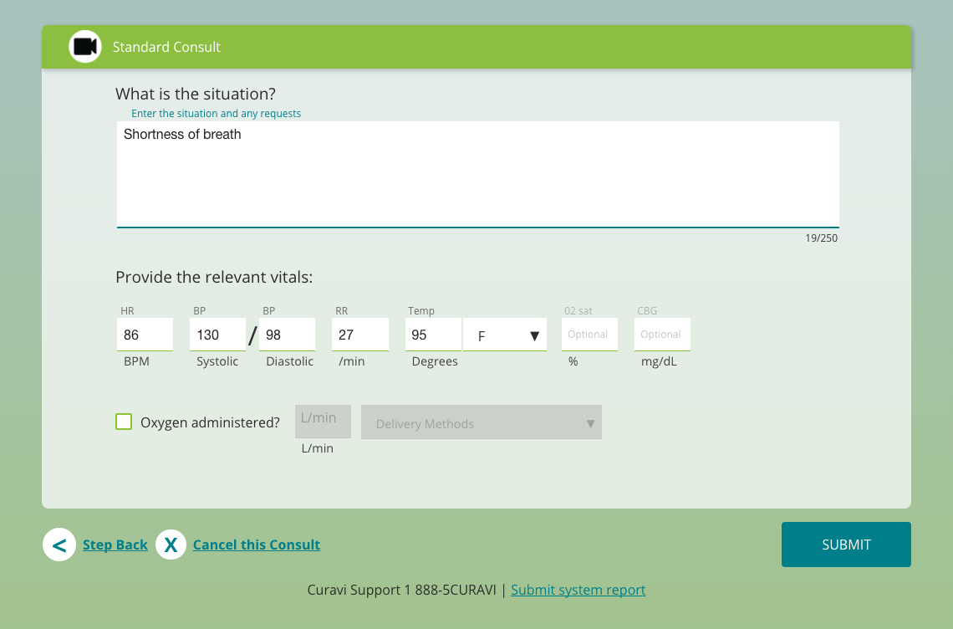

Slide 21
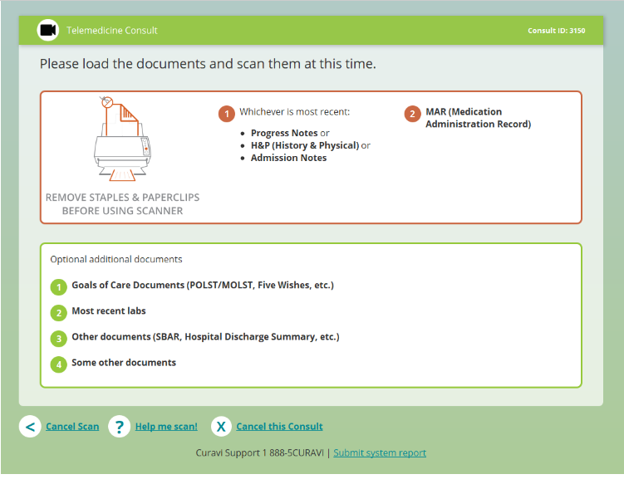
Notes:
On back of the CuraviCart, place documents facedown in scanner
Scanner scans up to 50 pages, front & back
No number input needed. Scanned documents go the provider performing the consult
Utilize on the scan & stop button only, please press SCAN once & wait for documents to process

Slide 22
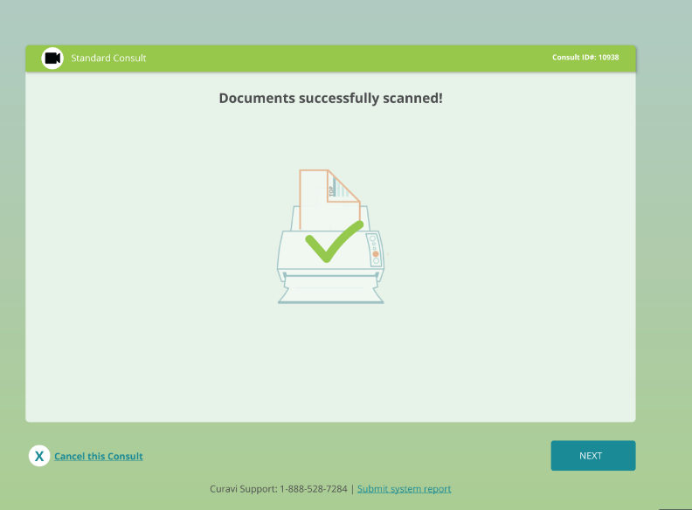
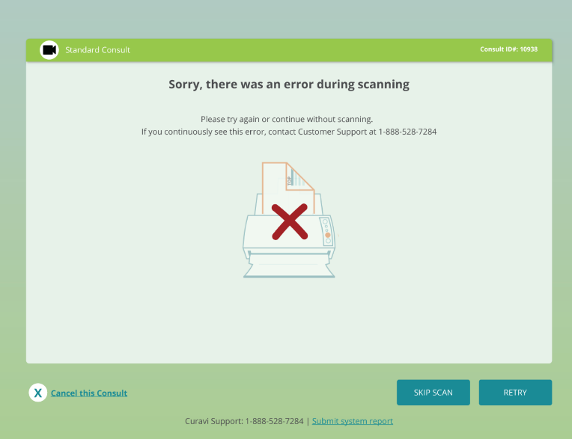

Slide 23
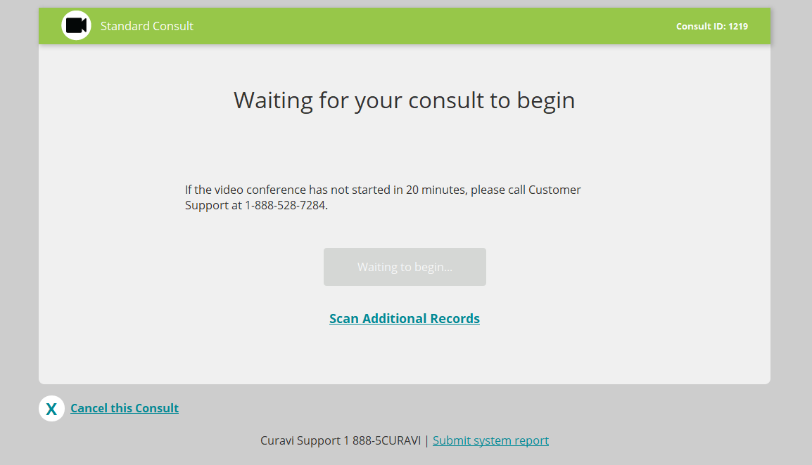

Slide 24
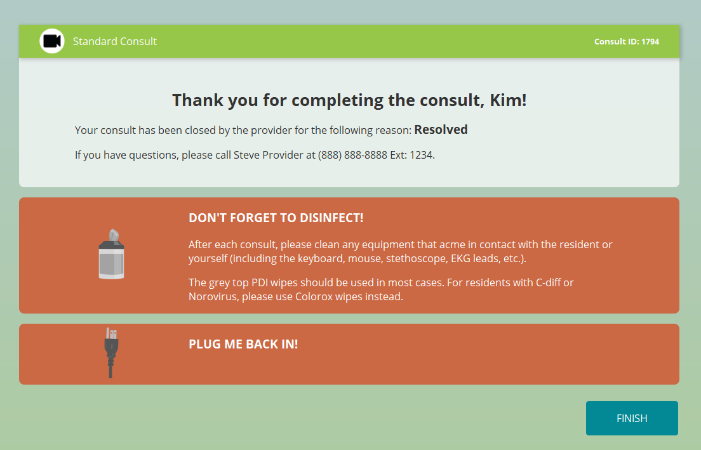

Slide 25
Video Screen During a Consult
Notes:
The Telemedicine Physician will initiate the video and the telepresenter will hear the sound of a bell, which means it is time to start the video conference.
The Telemedicine Physician introduces himself or herself.
The Telemedicine Physician continues with the assessment and examination.
Staff receive & recall verbal orders with physician prior to discontinuing the video.

Slide 26
EKG
Your Facility Name
a
Click 12-Lead EKG to begin read
Notes:
Your facility may not utilize the capabilities of our 12 lead EKG. Contact your account manager for information and details.

Slide 27
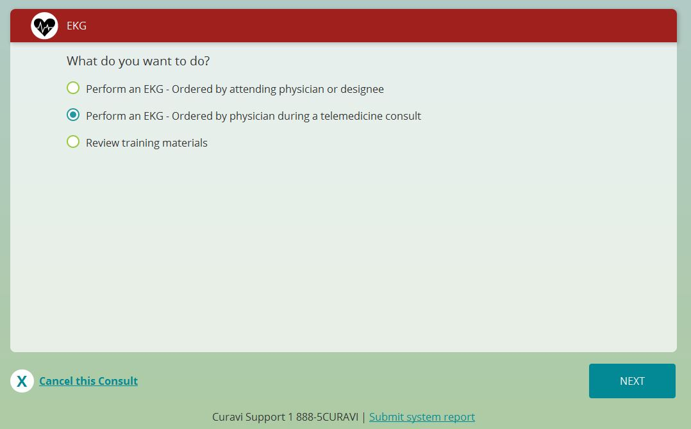
If ordered by physician following video consult, select this option.
Notes:
This option auto populates the resident information but can only be done following a telemedicine video consult

Slide 28
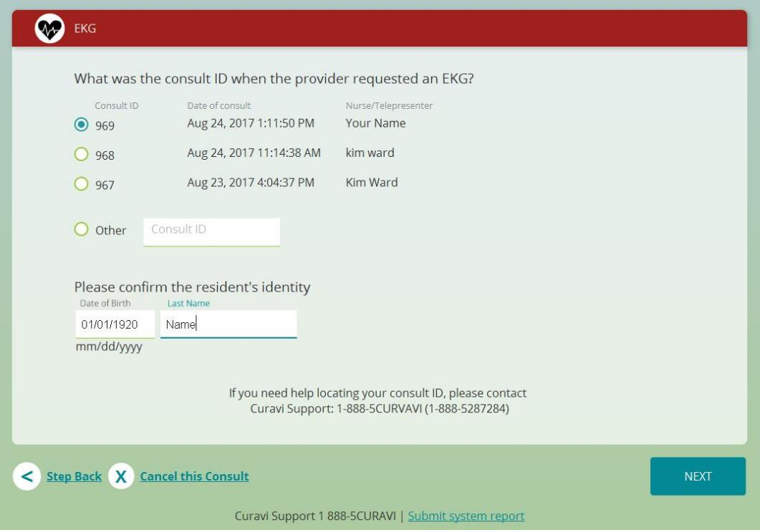
Select the consult involved with the appropriate ordered EKG
Verify last name & date of birth of the resident
Notes:
If originally incorrect demographic information was put in, please contact Curavi Support to retrieve this information.

Slide 29
Notes:
Non- auto populated resident demographics
Any ordered EKG outside of the video consult

Slide 30
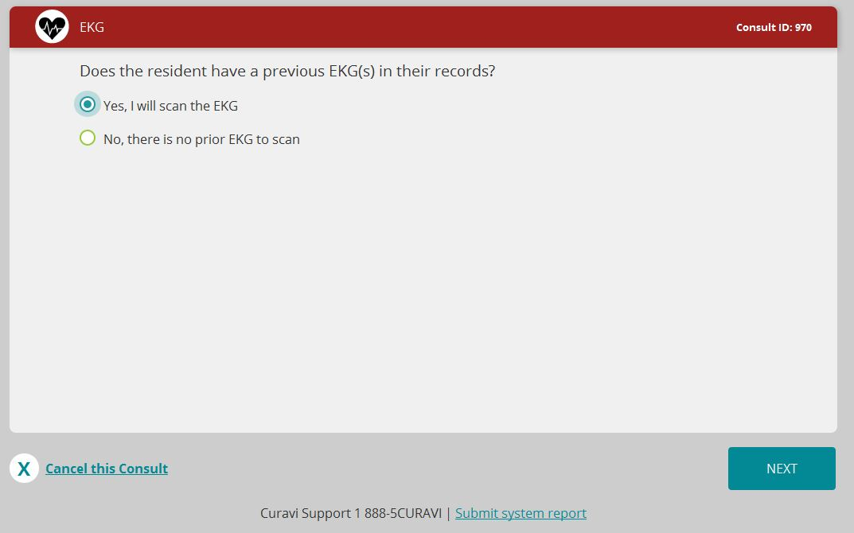

Slide 31
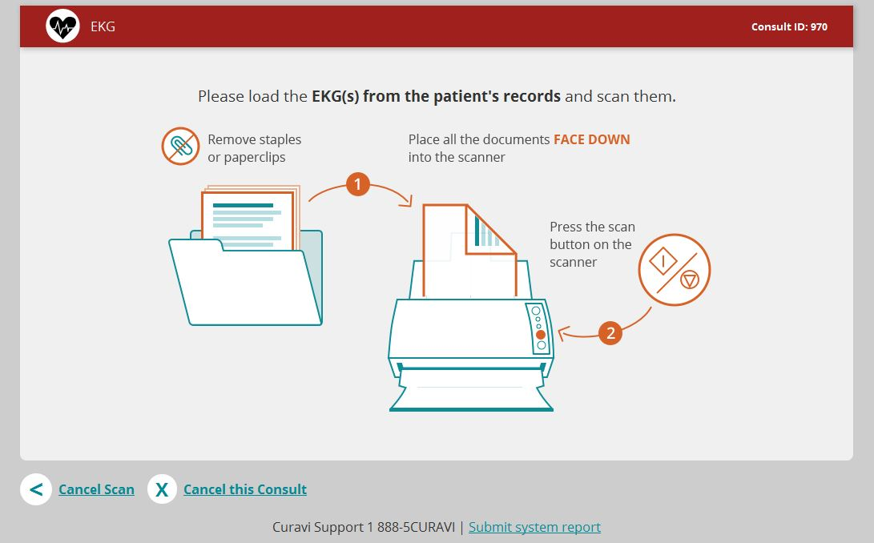

Slide 32
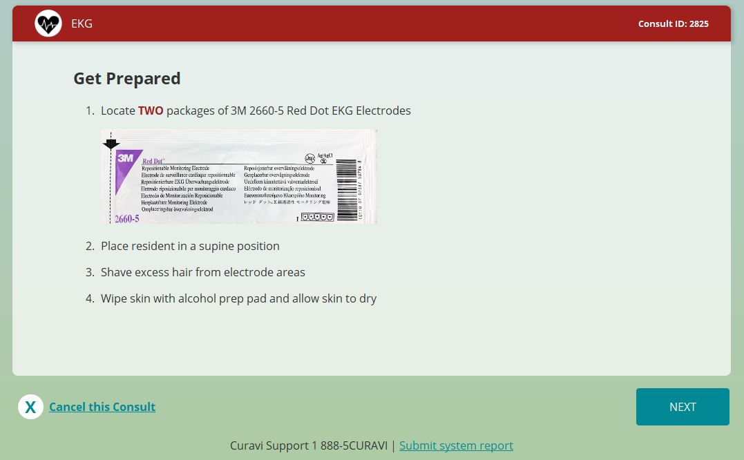

Slide 33
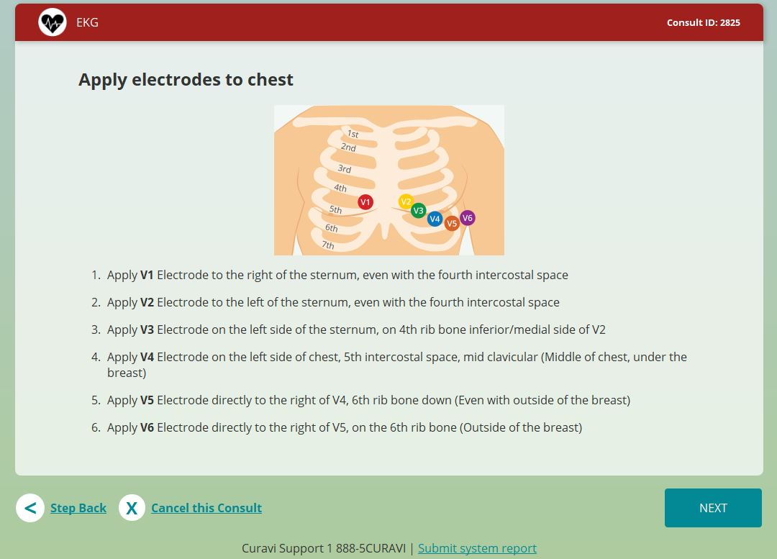
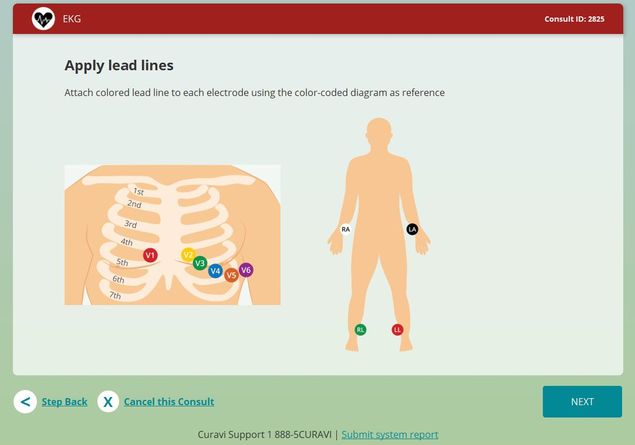
Review patch placement PRIOR to selecting NEXT

Slide 34
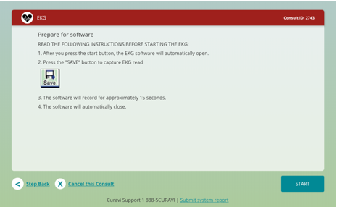

Slide 35
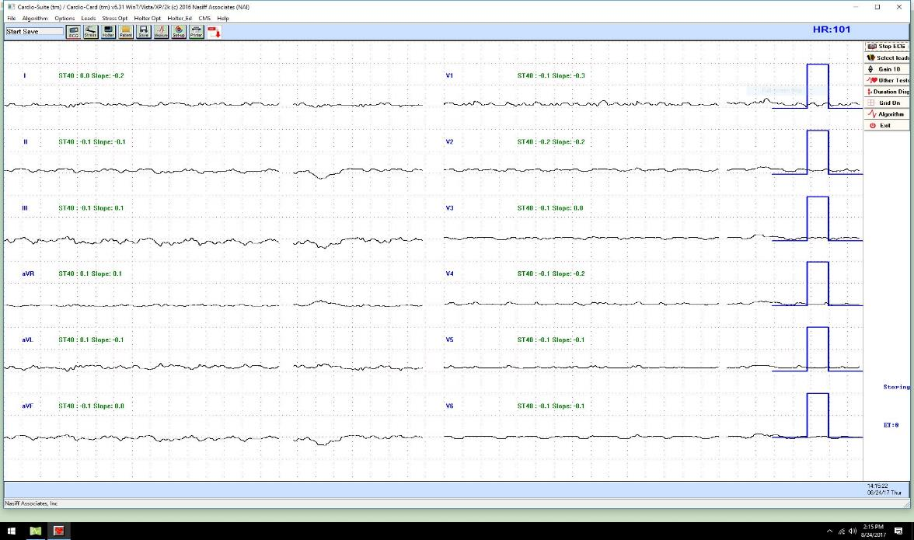
Select SAVE when ready to capture the preliminary read.
12-18 second count to completion
Notes:
Make any necessary adjustments to patch placement
Ensure clothing is not touching the lead lines
Have resident lay as still as possible with upper & lower extremities supported
Turn off oxygen concentrators if able, as well as tv volumes
Follow all of these steps prior to selecting save

Slide 36
Allows you to re-adjust & try again
Sends to physician & prints out on facility fax machine

Slide 37
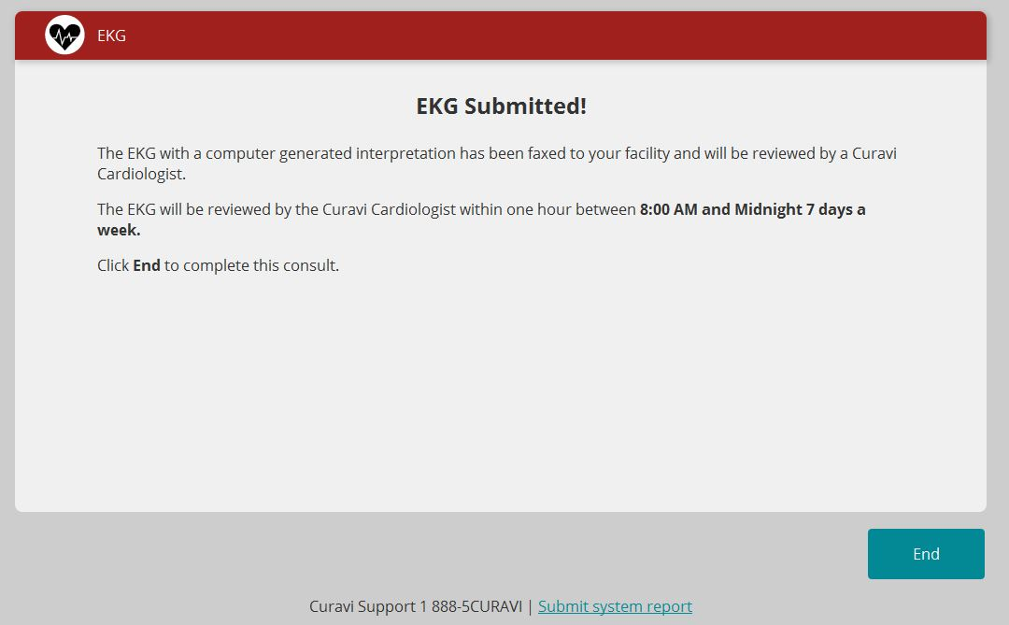
Once completed, collect your preliminary EKG print out via fax machine
Notes:
Final interpretation will be returned by physician
Expect print out from fax machine

Slide 38
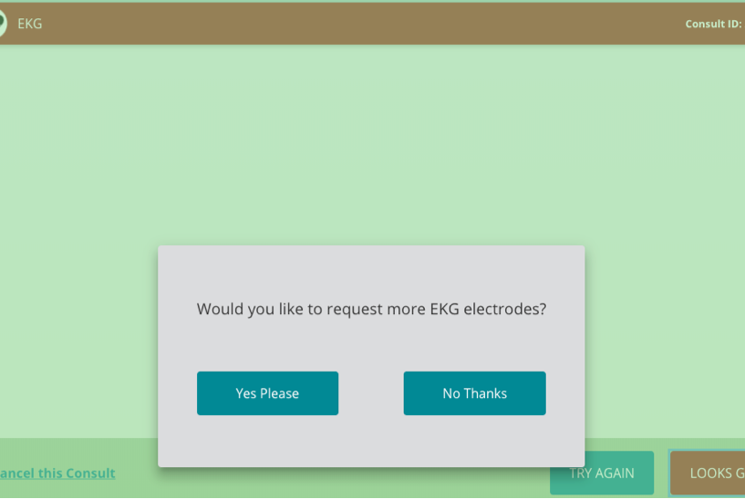

Slide 39
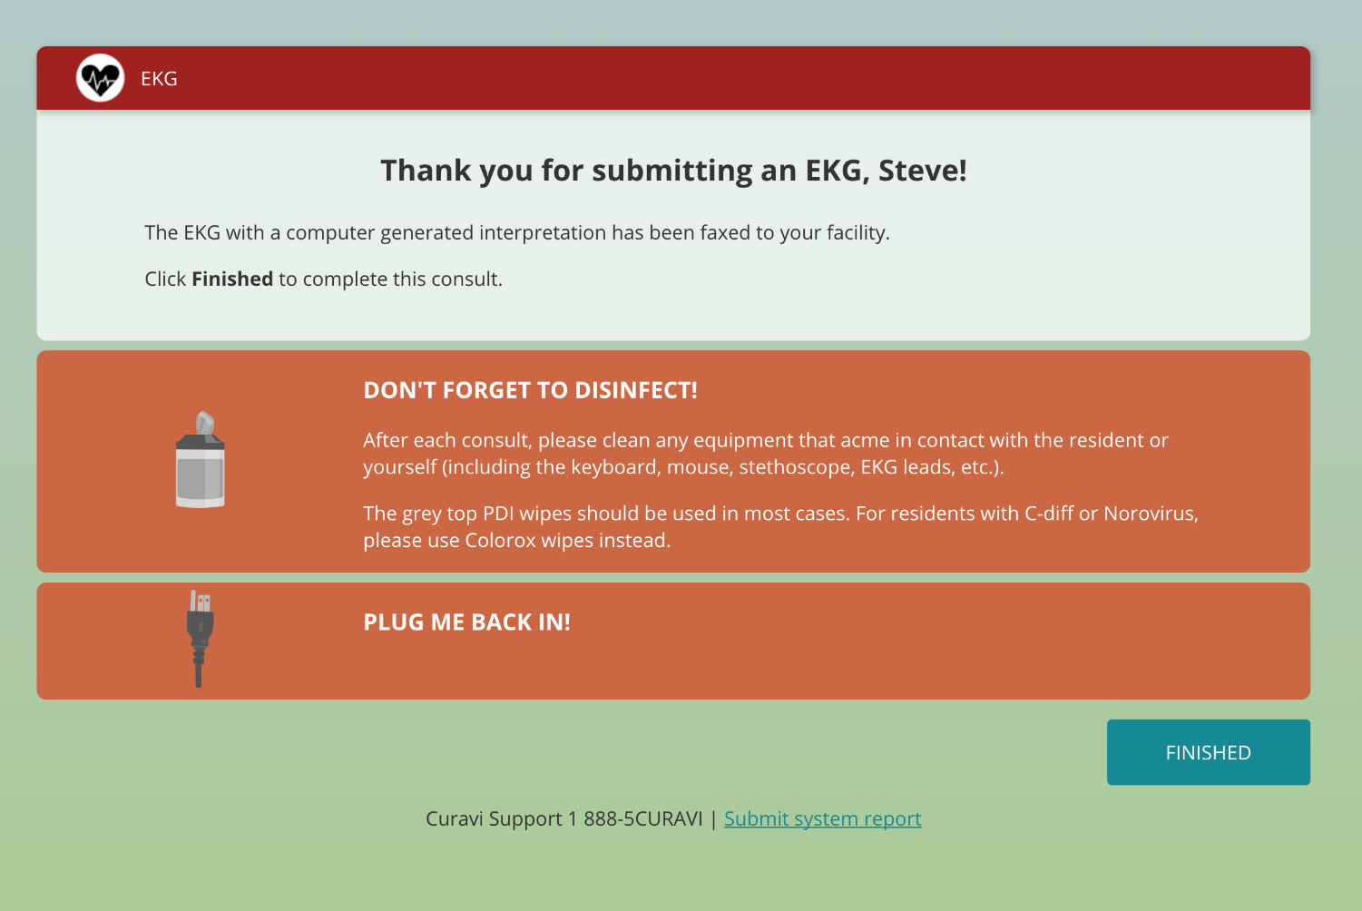

Slide 40
Almost Done…..
Once the exam is complete the following shall occur:
The Telemedicine Physician shall:
The Telepresenter shall:
Confirms the plan of care
Provides verbal orders
Confirms follow up care
Writes the verbal orders and reads back them back
Closes the consult
Implements all orders
Contacts POA/family as appropriate
Documents the telemedicine occurrence
Notes:
A very brief nursing note should be entered into the Resident's chart by the telepresenter.
An Example of a Verbal Order: Date: Verbal order via telemedicine by Dr. .
X-ray of chest AP and lateral: send results to Dr. (write Attending Physician's name)
Your name and signature

Slide 41
Having trouble?
Speaker/Microphone issues
Make sure the speaker is not muted (if light is red, make it green)
Otoscope not working
Check batteries (located in top drawer)
Check USB connection
Stethoscope not working
Check battery (located in top drawer)
Ensure Bluetooth connectivity
Internet Connectivity issue
Check wireless status
If the cart appears to be asleep or not working, it may need to be plugged in.
1-888-5CURAVI
(1-888-528-7284)

Slide 42
Having Trouble During Consult?
Closing CuraviCare APP
Re-launching CuraviCare APP
Select Red close box
Click “X” at top right of the CuraviCare screen.
Select “Quit CuraviCare” from pop-up box.
Select “CuraviCare” APP from main screen.
Wait for Physician to ((Ding)) in on Curavi Cart!

Slide 43
Technical Support
If an issue is not resolved contact CuraviSupportTM. They are available to help 24 hours a day
1-888-5CURAVI
(1-888-528-7284)
If technical difficulties occur during a telemedicine consult, the Telemedicine Physician will call you on the phone to the determine appropriate course of action.

Slide 44
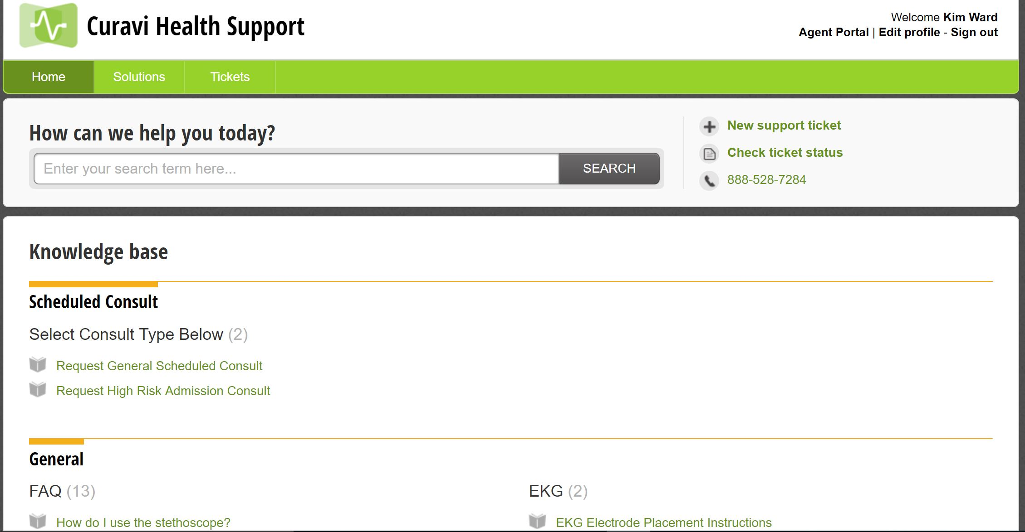
Notes:
CuraviSupportTM is located on the desktop of the CuravCartTM, click on the icon to open the application. This is a library of training materials that are available to help with answering common questions. CuraviSupportTM is available at all times, even when a consult is not in progress. If you have a technical difficulty, please submit a ticket. This will allow us to address your concern in an efficient manner

Slide 45
Prior to providing training, please click “Enter Training Mode” to utilize CuraviCare™ and CuraviCart™ .

Slide 46
Appendix for Train - the -Trainers Potentially Avoidable Hospitalizations

Slide 47
Congestive Heart Failure Exacerbation Signs/Symptoms
Frequent dry hacking or moist cough
Worsening shortness of breath with activity or shortness of breath at rest
Increased discomfort or swelling (edema) in the legs, feet, and ankles
Lung sounds – new or worsening rales
Sudden weight gain of more than 2-3lbs in a 24 hr. period, 5 lbs. in a week
Discomfort or swelling in the abdomen
Trouble sleeping, cannot lie flat
New or worsening dizziness, confusion, sadness, depression, or fatigue
Loss of appetite
Fall
BNP>300
http://www.heart.org/idc/groups/heart-public/@wcm/@hcm/documents/downloadable/ucm_477328.pdf)
Notes:
* Blood Oxygen saturation level below 92% on room air or on usual O2 settings in patients with chronic oxygen requirements.
* New or worsening rales in lungs
* New or worsening edema
* New or increased jugular-venous distension
*BNP > 300

Slide 48
Pneumonia Signs/Symptoms
Cough with phlegm
Chest pain when breathing or coughing,
Labored breathing or shortness of breath (RR>24)
Blood Oxygen saturation level < 92% on room air or on usual O2 settings in patients with chronic oxygen requirements.
Evidence of focal pulmonary consolidation including rales, rhonchi, decreased breathe sounds, or dullness to percussion
Coughing up phlegm
Fever, chills * older adults sometimes have lower than normal body temperature
Feels suddenly worse after a cold or flu
Nausea, vomiting, diarrhea
Confusion, delirium
http://www.nhlbi.nih.gov/health/health-topics/topics/pnu/signs
Notes:
* Fever >100 F (oral) or two degrees above baseline
* Blood Oxygen saturation level < 92% on room air or on usual O2 settings in patients with chronic oxygen requirements
* Respiratory rate above 24 breaths/minute
* Evidence of focal pulmonary consolidation including rales, rhonchi, decreased breath sounds, or dullness to percussion

Slide 49
COPD/Asthma Exacerbation Signs/Symptoms
Sudden or sustained worsening of dyspnea
O2sat 92% or less on RA, RR >24
Wheezing
Cough, or sputum production, or change in viscosity, color, volume
Increased use of maintenance medications
Elevated temp and pulse rates, drop in BP & and change in mental status in critically ill individuals
http://rnao.ca/sites/rnao-ca/files/Nursing_Care_of_Dyspnea_-The_6th_Vital_Sign_in_Individuals_with_Chronic_Obstructive_Pulmonary_Disease.pdf
Notes:
Symptoms of wheezing, shortness of breath, or increased sputum production
* Blood Oxygen saturation level below 92% on room air or on usual O2 settings in patients with chronic oxygen requirements
* Acute reduction in Peak Flow or FEV1 on spirometry
* Respiratory rate > 24 breaths/minute

Slide 50
UTI Signs/Symptoms
Change in mental status
Lower Abdominal pain
Shaky, weak, muscle aches
Urine may look cloudy, bloody or foul smelling
Fever not attributed to any other cause
Peripheral WBC count >14000.
Dysuria, new or increased urinary frequency, new or increased urinary incontinence, gross hematuria, or acute costovertebral angle pain or tenderness
Fall
https://www.niddk.nih.gov/health-information/health-topics/urologic-disease/urinary-tract-infections-in-adults/Pages/facts.aspx#signs
Notes:
Fever > 100 F (oral) or two degrees above baseline
* Peripheral WBC count > 14,000.
* Symptoms of: dysuria, new or increased urinary frequency, new or increased urinary incontinence, altered mental status, gross hematuria, or acute costovertebral angle pain or tenderness

Slide 51
Dehydration / Acute Kidney Injury
Reduced urine output in 24 hours or reduced oral intake by approximately 25% or more of average intake for 3 consecutive days
New onset of Systolic BP < 100 mm Hg (Lying, sitting or standing)
20% increase in Blood Urea nitrogen (e.g. from 20 to 24) OR 20% increase in Serum Creatinine (e.g. from 1.0 to 1.2)
Sodium > 145 or < 135
Orthostatic drop in systolic BP of 20 mmHg or more going from supine to sitting or standing
Fall
Change in mental status
Notes:
* Reduced urine output in 24 hours or reduced oral intake by approximately 25% or more of average intake for 3 consecutive days
* New onset of Systolic BP < 100 mm Hg (Lying, sitting or standing)
* 20% increase in Blood Urea nitrogen (e.g. from 20 to 24) OR 20% increase in Serum Creatinine (e.g. from 1.0 to 1.2)
* Sodium > 145 or < 135
* Orthostatic drop in systolic BP of 20 mmHg or more going from supine to sitting or standing

Slide 52
Skin Ulcers / Surgical Wound Infection / Cellulitis
New onset of painful, warm, reddened, and/or swollen/indurated area of skin
If associated with a skin ulcer or wound there is change of condition with signs of infection such as purulence, exudate, fever, new onset of pain, and/or induration
Fever
Drainage from surgical site, reddened, and/or swollen incisional area
Notes:
New onset of painful, warm and/or swollen/indurated skin infection
If associated with a skin ulcer or wound there is an acute change in condition with signs of infection such as purulence, exudate, fever, new onset of pain, and/or induration.

