Slide 1
HVI Provider Pilot
Training
June 2018

Slide 2
The purpose of the HVI Virtual Rounding Project is to enable HVI Providers to round remotely and on-demand for residents who are at the
UPMC Canterbury Place Nursing Facility-Transitional Care/Heart & Vascular Unit
Notes:
1.

Slide 3
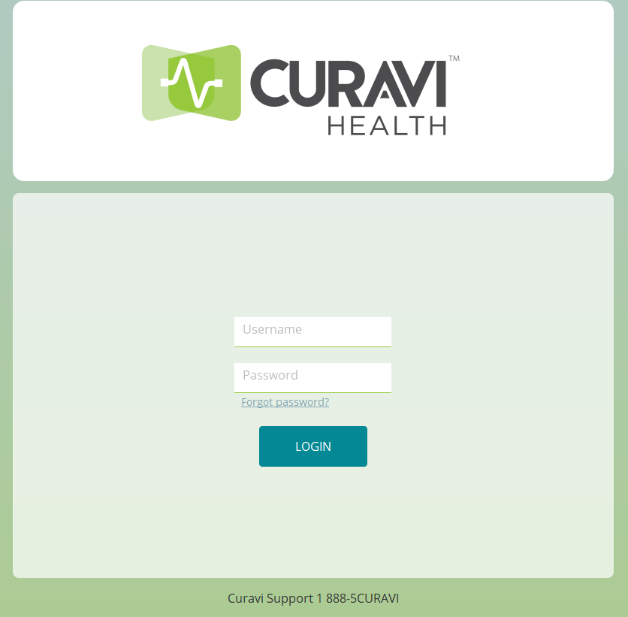
2. Log in with user name and password to begin.
Your user name is
First name.Last name
1. CuraviCare icon that is found on your desktop
24/7 Support
1-888-528-7284

Slide 4
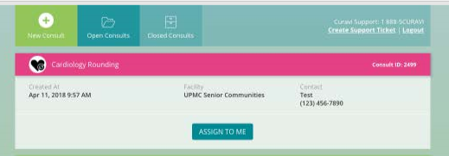
Click ASSIGN to ME

Slide 5
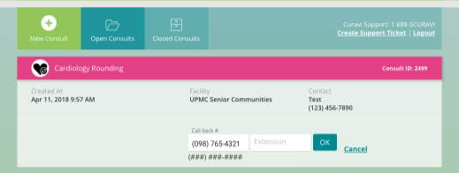
In the event of technical difficulties, we ask for your contact information. Click OK when finished.

Slide 6
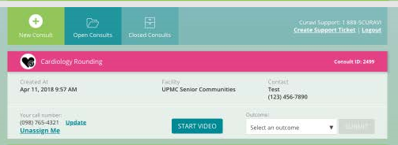
Click START VIDEO

Slide 7
PTZ Camera Control
Help

Slide 8
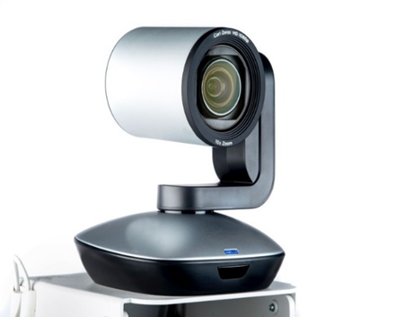
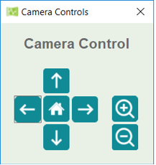
PTZ (Pan/Tilt/Zoom) camera is located on the top of the cart and can be controlled by the provider to provide a better view of the resident.
Click on the crossing arrows button and the following dialog will appear. Simply click and hold any arrow button until the camera is in the correct position. It may be easier to fine tune the adjustments with a quick click and release of any button. Click the + or – buttons to zoom in or out and the home button to return to center.

Slide 9
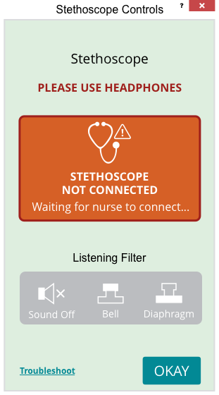
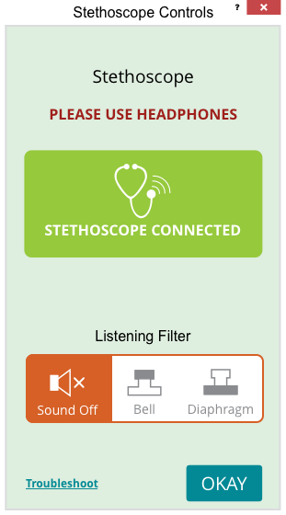
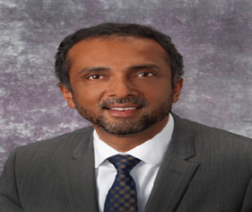
1.
2.
Once the stethoscope is connected, you will be able to control the listening filters
Clicking this icon will pop up the windows.

Slide 10
At the end of rounding, please click END

Slide 11
Choose reason for ending rounding, enter how many residents seen and click SUBMIT

Slide 12
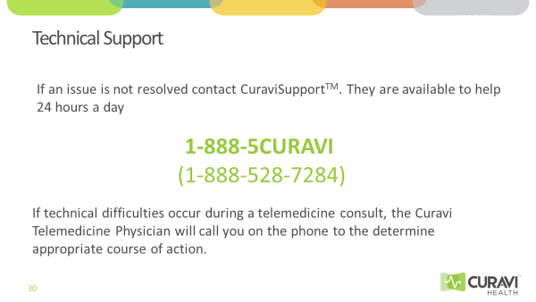

Slide 13
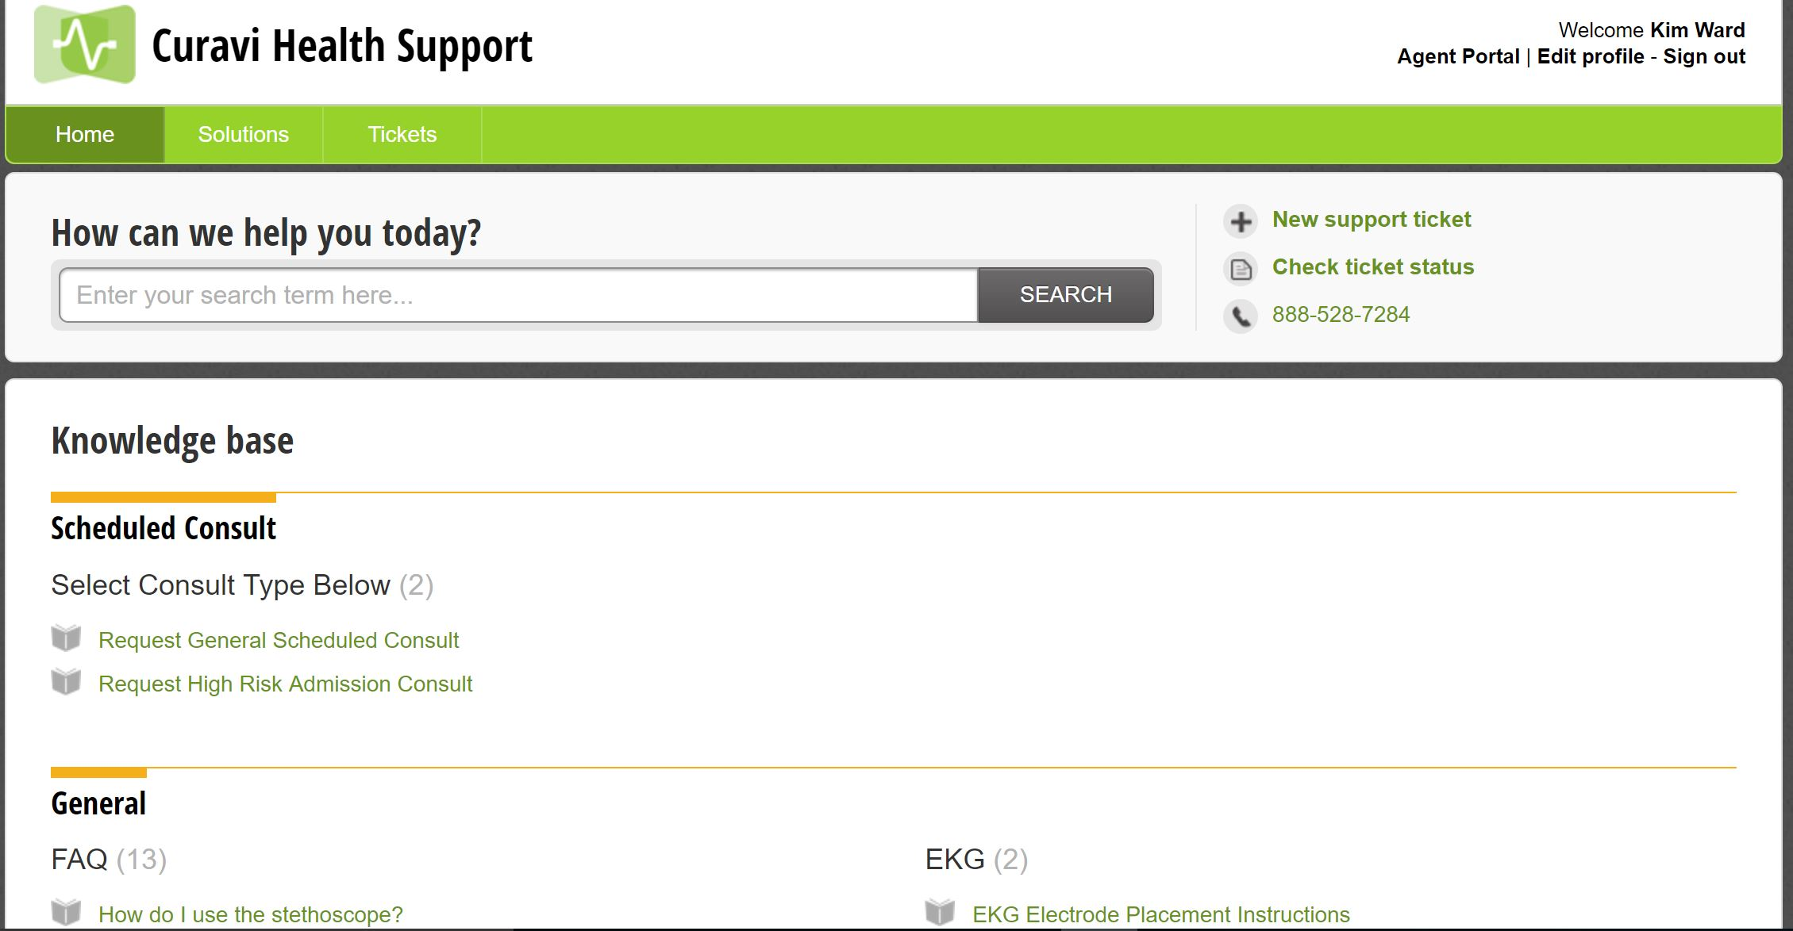
CuraviSupportTM
Notes:
CuraviSupportTM is located on the desktop of the CuravCartTM, click on the icon to open the application. This is a library of training materials that are available to help with answering common questions. CuraviSupportTM is available at all times, even when a consult is not in progress. If you have a technical difficulty, please submit a ticket. This will allow us to address your concern in an efficient manner.
I added this to the Provider slide deck

